Slide 1
My University is My Alma Mater

Slide 2
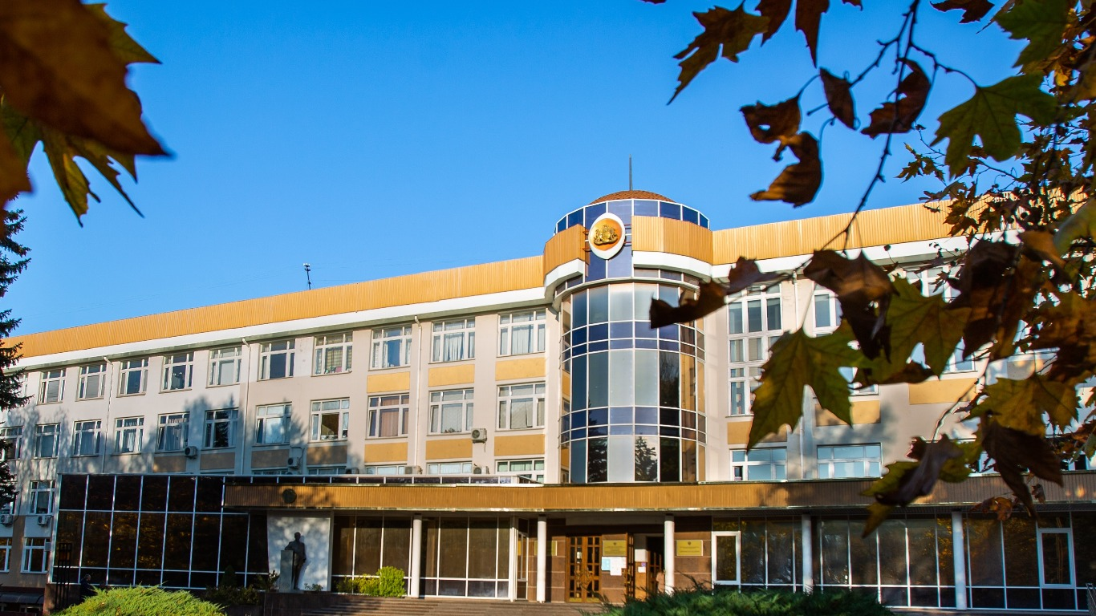
The history of the V. I. Vernadsky Crimean Federal University
V. I. Vernadsky Crimean Federal University is located in Simferopol, is the largest higher education institution in the Republic of Crimea, and is one of the ten federal universities of the Russian Federation.

Slide 3
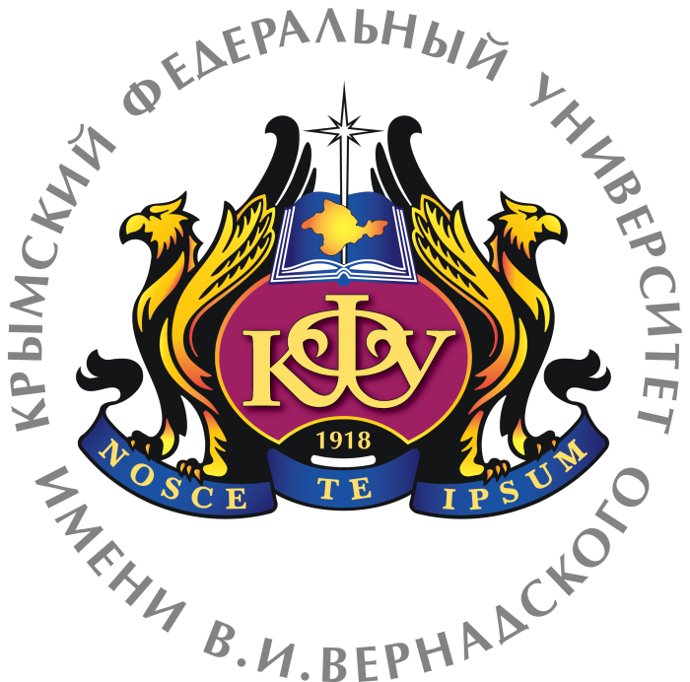
The history of the V. I. Vernadsky Crimean Federal University
V.I. Vernadsky Crimean Federal University (KFU) is the successor of the first higher educational institution in Crimea – Taurida University, established in 1918 on the initiative of Solomon Samoilovich of Crimea.

Slide 4
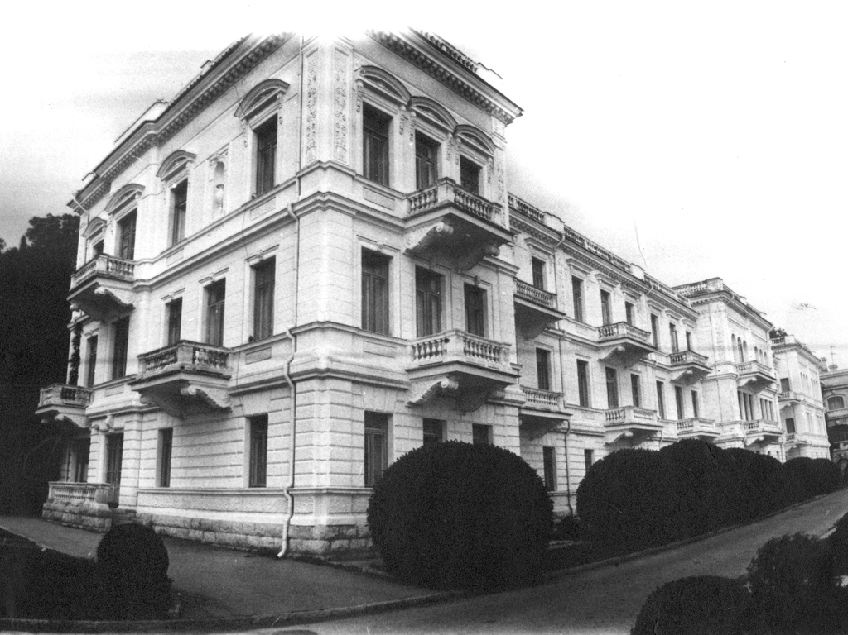
The history of the V. I. Vernadsky Crimean Federal University
In May 1918, lectures began at the Physics and Mathematics and Medical faculties located in Yalta. Since the autumn of 1918, all five faculties of the University – historical and philological, physical and mathematical, legal, medical and agronomic – have been concentrated in Simferopol. They were housed in the former buildings of the military hospital (Studencheskaya str., 10 and 12), the women's diocesan college (Lenin Boulevard, 5/7), the theological seminary (Geroyev Ajimushkaya Lane, 9), in a number of private houses.

Slide 5
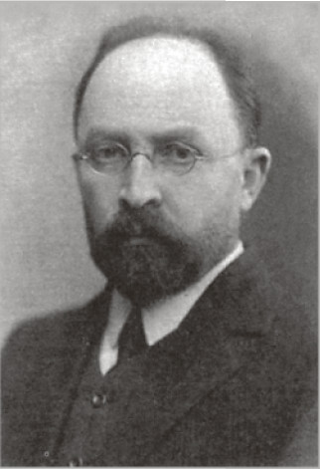
The history of the V. I. Vernadsky Crimean Federal University
Scientists of Kiev University stood at the origins of the creation of the Tauride University, who elected its first Council, headed by the rector, a prominent figure in medical science, Professor R. I. Helwig. On October 13, 1920, after Helwig's death, Academician V. I. Vernadsky was elected rector.

Slide 6
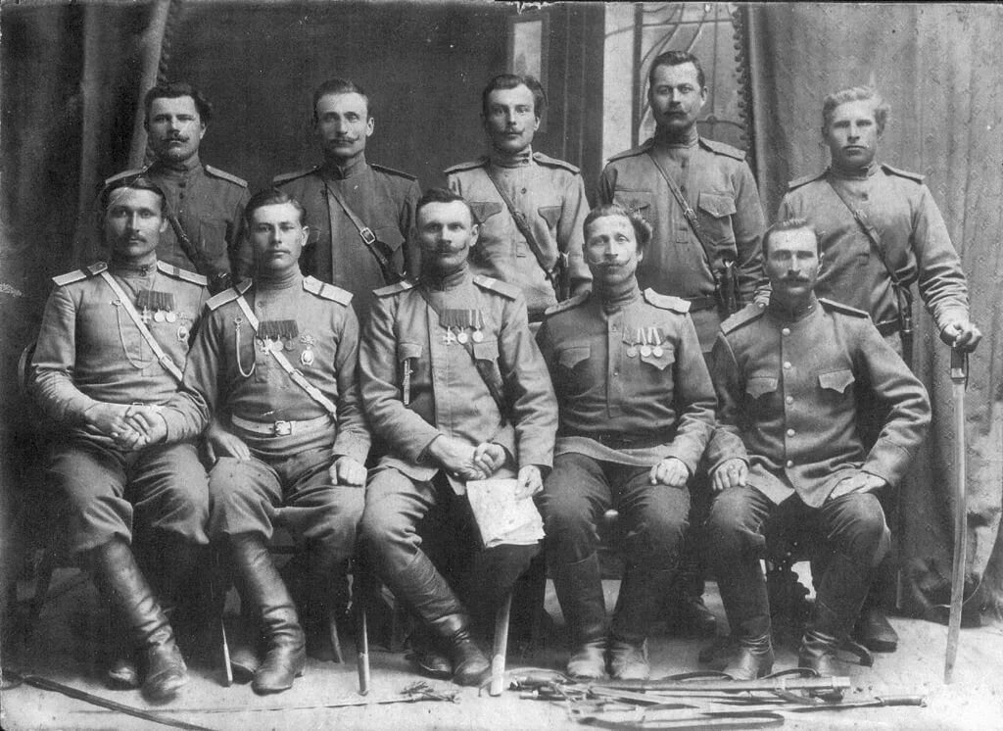
The history of the V. I. Vernadsky Crimean Federal University
During the reign of the White Guards and foreign interventionists, the university was in extremely difficult conditions. His teachers, in order to survive, took on any job: sawed firewood, sewed boots, etc. Over 20 professors and teachers were homeless, many students systematically starved.

Slide 7
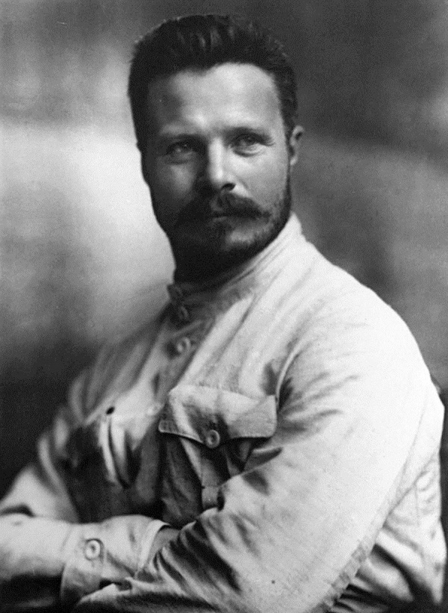
The history of the V. I. Vernadsky Crimean Federal University
After the final establishment of Soviet power, the university was reorganized. On February 1, 1921, it was renamed the Frunze Crimean University, and in the 20s and early 30s, three higher educational institutions were established on its basis – pedagogical, medical and agricultural institutes.
Mikhail Vasilyevich Frunze (February 2, 1885 - October 31, 1925)

Slide 8
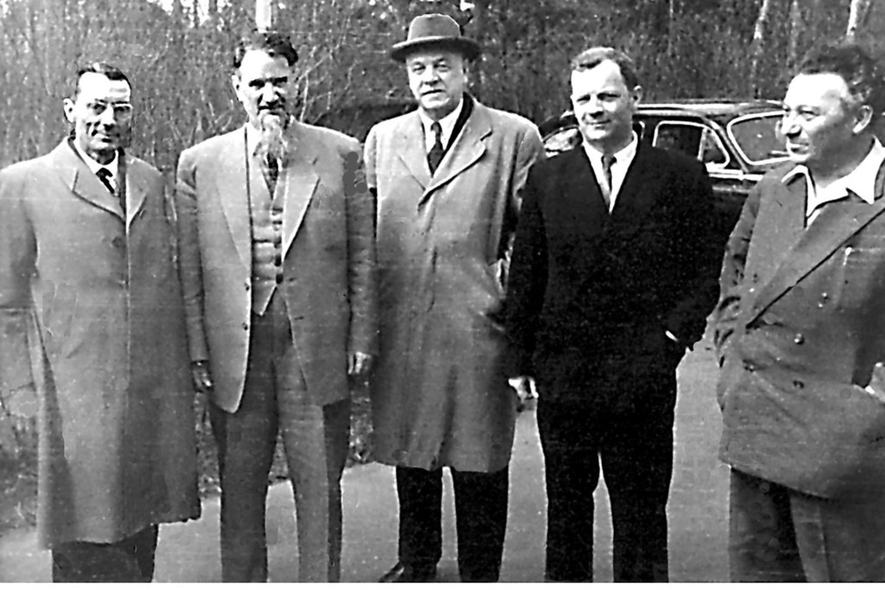
The history of the V. I. Vernadsky Crimean Federal University
At various times, such remarkable scientists as Academician D. I. Shcherbakov (1922), academician I. V. Kurchatov and Academician of the Academy of Sciences of the Ukrainian SSR K. D. Sinelnikov (1923), corresponding members of the Academy of Sciences of the USSR G. M. Frank (1925), K. I. Shchelknin (1932) graduated from the university.

Slide 9
The history of the V. I. Vernadsky Crimean Federal University
The 10 federal universities include leading Crimean universities, institutes, and research bases.
In February 1972, it was transformed into the Simferopol State University named after M. V. Frunze (SSU).
In 1925, the Crimean State Pedagogical Institute was established on the basis of the university.

Slide 10
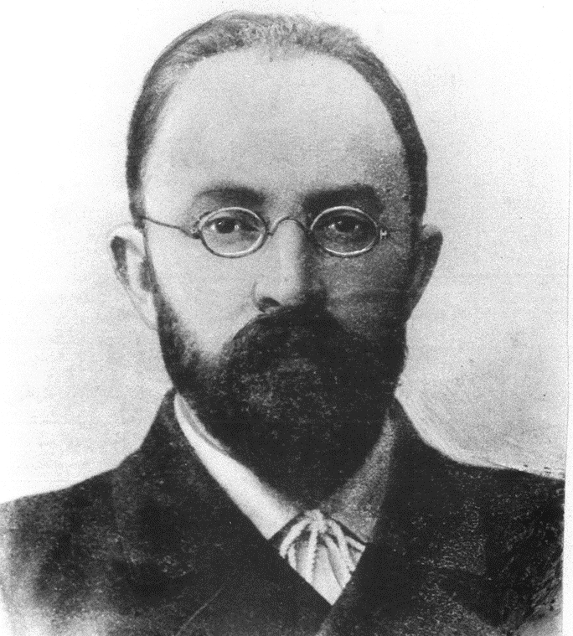
The First rector of the Tauride University
Helwig, Roman Ivanovich (September 12, 1873, Lipetsk, Tambov province — September 19, 1920, Simferopol) – russian scientist (anatomist), Professor, the first rector of the Tauride University.

Slide 11
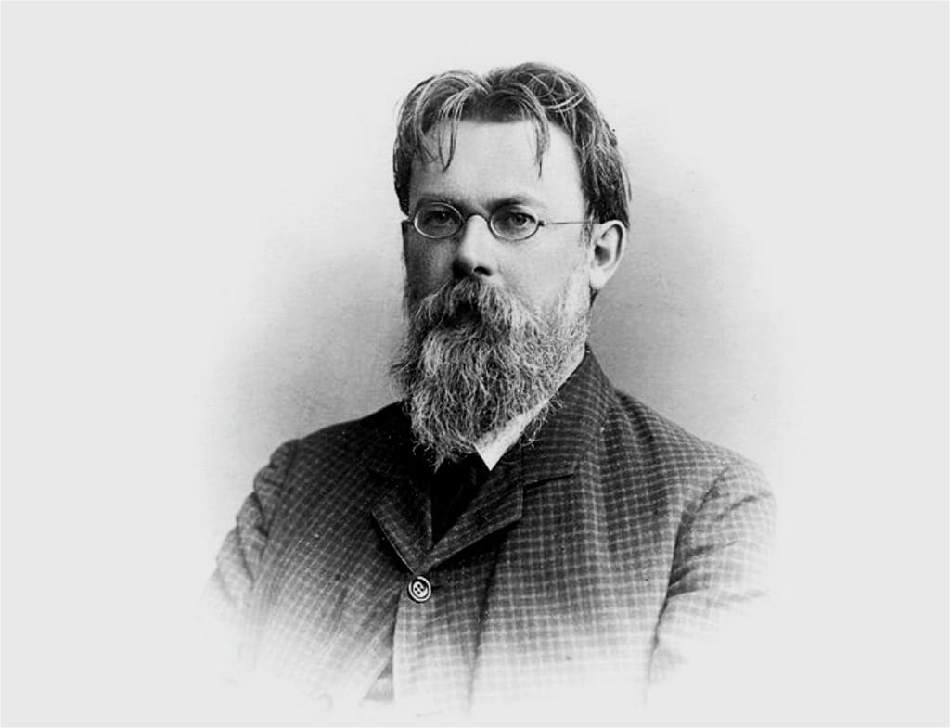
The second rector of the Tauride University
The second rector of the University from 1920 to 1921 was an outstanding Soviet natural scientist, the founder of geochemistry and biogeochemistry, Academician V. I. Vernadsky.

Slide 12
The history of the V. I. Vernadsky Crimean Federal University
Academician Vladimir Vernadsky, whose name is KFU, was a professor and the second rector of Taurida University (in 1920-21). The circle of interests of the outstanding Russian scientist, the founder of geochemistry and biogeochemistry, the first president of the Ukrainian Academy of Sciences, the author of the doctrine of the biosphere and noosphere included geology, soil science, crystallography, mineralogy, geochemistry, radiogeology, biology, paleontology, biogeochemistry, meteoritics, and philosophy with history.

Slide 13
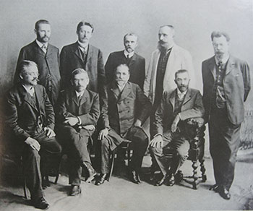
The history of the V. I. Vernadsky Crimean Federal University
The years of the university's existence (1918 – 1925) are at the same time the Crimean years of life and activity of a whole galaxy of outstanding scientists. Many of the university professors are now the pride of Russian science: academicians V. I. Vernadsky, V. A. Obruchev, A. A. Baykov, V. I. Palladin, A.V. Palladin, P. P. Sushkin, V. I. Smirnov, N. M. Krylov, A. F. Ioffe, I. E. Tamm, B. D. Grekov, E. P. Pavlovsky.

Slide 14
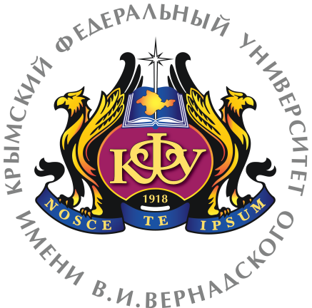
The history of the V. I. Vernadsky Crimean Federal University
Intentions to create a new federal university were expressed on March 31, 2014 by Prime Minister Dmitry Medvedev at a government meeting in Simferopol. On April 10, in an interview with the Izvestia newspaper, the Minister of Education and Science of Russia, D. V. Livanov, announced that a federal university would be established "on the basis of the Tauride Vernadsky University."

Slide 15
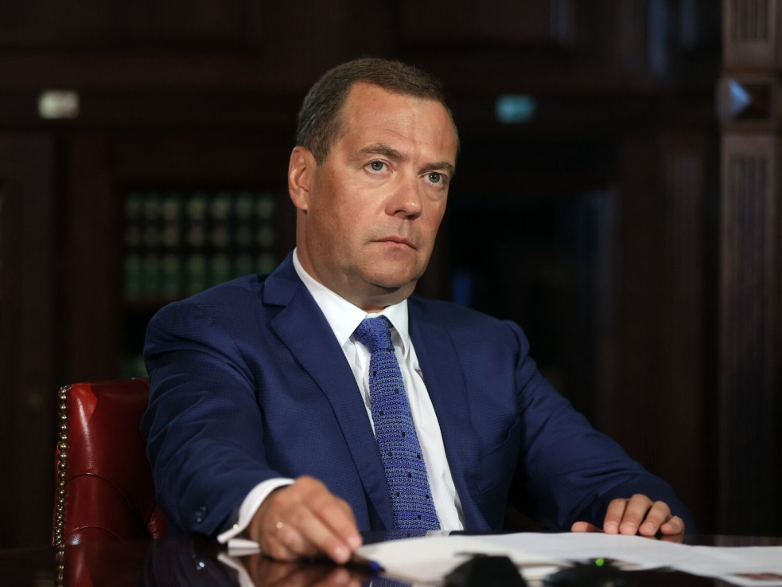
The history of the V. I. Vernadsky Crimean Federal University
On August 4, 2014, by decree of the Chairman of the Government of the Russian Federation D.A. Medvedev, the Vernadsky Crimean Federal University was established.

