Slide 1
The formation of the concept of "medicine" in linguistic cultures
Beitullaev A. M.
1-st year postgraduate student of the Department of Basic and Clinical Pharmacology of the Order of the Red Banner of Labour Medical institute named after S. I. Georgievsky, V. I. Vernadsky Crimean Federal University
Scientific adviser: PhD in Pedagogy, docent Chernyshova T. G.

Slide 2
Introduction
It is difficult for modern people to imagine their lives without medicines, as they improve the quality and longevity of life. Today, drugs are seen as a benefit of civilization, and if you think about it, they have existed for only a century in the form to which we are accustomed. However, medicine has existed since ancient times, and people from different cultures treated and used it in their own way. It is important to analyze the origin of drug, as well as how it was interpreted and understood in different cultures and at different stages of human history.

Slide 3
The aim of the work, materials and methods
The aim of this work
was to analyze the origins of the concept of "medicine" in different linguistic cultures.
The objectives of the work
are to explore the history of the term "medicine", its origins, and the factors that have influenced its reinterpretation over time.
The research methods
involved a retrospective analysis of historical data sources to investigate the origins of the concept of "medicine" within various linguistic cultures.

Slide 4
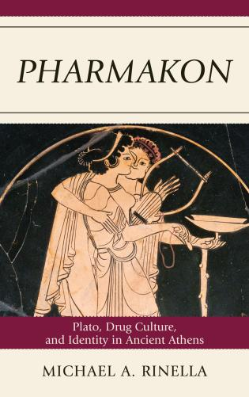
Ancient Greek
The concept of "medicine", which gave rise to the word "pharmacy", which is known to us today, and the name of the scientific discipline of pharmacology, has an ancient Greek origin. It originated from the ancient Greek term "pharmakon", which simultaneously referred to both a poison and a medicinal substance. This concept emerged in the 5th-4th centuries BC.

Slide 5
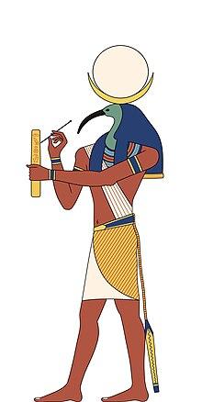
Ancient Egypt
There is another interesting theory about the origin of this idea. In Ancient Egypt, the healing arts were under the protection of the god Thoth, who the Egyptians called "Phar-ma-ki". Translated, this means "protector", "healer" and "foreboding". It's possible that the Greeks borrowed the ancient Egyptian word for medicinal treatment, which already existed. The etymology of this word is fascinating: it refers to a figure who knows how different substances can help fight diseases. They are said to have secret knowledge, not only related to their profession in the field of medicine but also to an intuitive understanding of the patient's needs. First of all, doctors have to understand the fine line between a poison and a healing substance. In ancient times, everything related to drug was called "medicamentum" in Latin. Today, we use this term when talking about drug treatments, that is, treatments involving taking various medications.

Slide 6
Ancient China
Eastern cultures are known for their imaginative thinking and unique philosophy. This is why the term "medicine" has a completely different meaning in these cultures compared to Western and even Ancient Egyptian traditions. In ancient China, the word for "medicine" originated from the hieroglyph of "music". This is not a coincidence. The Ancient Chinese used music not only to cure diseases but also to purify the soul and mind, calm down and normalize biorhythms. They treated music long before they discovered that herbs could also heal diseases. The hieroglyph "music" was combined with a smaller upper part that denoted the concept of "herbs". Together, they began to represent "medicine".. So, the combination of music and grass gave rise to a new concept: medicine. In ancient India, the idea of drug was integrated into the general medical system, Ayurveda, which means "knowledge about life and long-term health“.

Slide 7
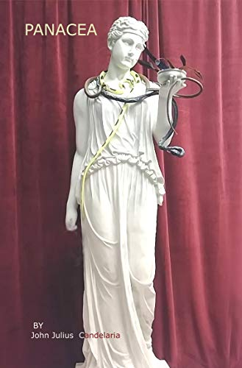
Middle Ages and Renaissance
In the Middle Ages and Renaissance, with the advent and development of alchemy, iatrochemistry, and iatrophysics, a concept known as "panacea" emerged. This term denotes a kind of mythical, universal medicine capable of treating all diseases without exception. Iatrochemists searched for this drug and its formula, as the word "panacea" comes from ancient Greek mythology and is formed on the basis of the name of the goddess Panacea. The goddess, considered to be capable of healing with a single touch, was the daughter of the healing god Asclepius and the goddess Epione who had the power to relieve pain. Obviously, "panacea" is the Latinized name of the ancient Greek goddess. This name stood for "pan" – "everything" and "akos" – "treat"

Slide 8
Middle Ages and Renaissance
The traditions of alchemy and, in particular, medieval pharmacy were heavily influenced by these ideas. It is also important to note that in the Middle Ages, the roles of a doctor and a pharmacist were distinct. The pharmacists actually had secret knowledge and held absolute authority in society. Pharmacies were established in large numbers in all medieval towns. Over time, alchemy's role was replaced by what is known as iatrochemistry. According to this theory, all processes in human and animal bodies take place chemically, using "enzymes" as catalysts. Human illness is seen as a result of a chemical imbalance. Therefore, treatment involves the administration of necessary chemicals to the body. The word "placebo" has an interesting origin that has been widely used in modern medicine (since the 19th century). A placebo is a dummy drug with no medicinal properties that is given to patients in two situations: as an experiment or test of the effectiveness of a drug. The term comes from the Latin word "placebo", which means "I will be pleased" or "I will enjoy"

Slide 9
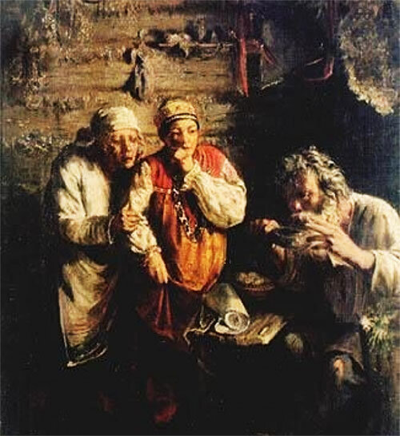
The Slavic languages
As for the Slavic languages, the word "lekarstvo" (medicine) in Russian comes from the verb "lechit’" (treat), that is the term for medicine has its direct meaning. In other Slavic languages, drug is designated by the word "lek". This name is actually common in the Slavic worldview. It is very interesting that in Old Slavic, the doctor was called a "tselevnik" (healer). This is because "healer" means "the one who cures", "restores", or "gives a chance to live".
Hence, healing properties are often synonymous with medicinal properties in these languages. It is important to note that, towards the middle of the 19th century, when medicine began to develop rapidly and spread worldwide as a science, these cultural values were formally lost. Most people in each nation still have a respect for their ancient traditions, and an understanding of why medicine is named the way it is, but for the most part, developments in drug and technology have erased national differences in terminologies.

Slide 10
Conclusion
In conclusion, it can be said that there is a connection between people's beliefs and the etymology of words. In Western and Slavic cultures, the idea of remedies was directly linked to their purpose. However, in Eastern cultures, this idea was based on images that represented what could really heal. Therefore, medicine as a discipline is based on philosophical principles that go beyond the activities of the doctor, and the concepts that he or she uses to communicate and share their unique and specialized knowledge.

Slide 11
Thanks!

