Slide 1
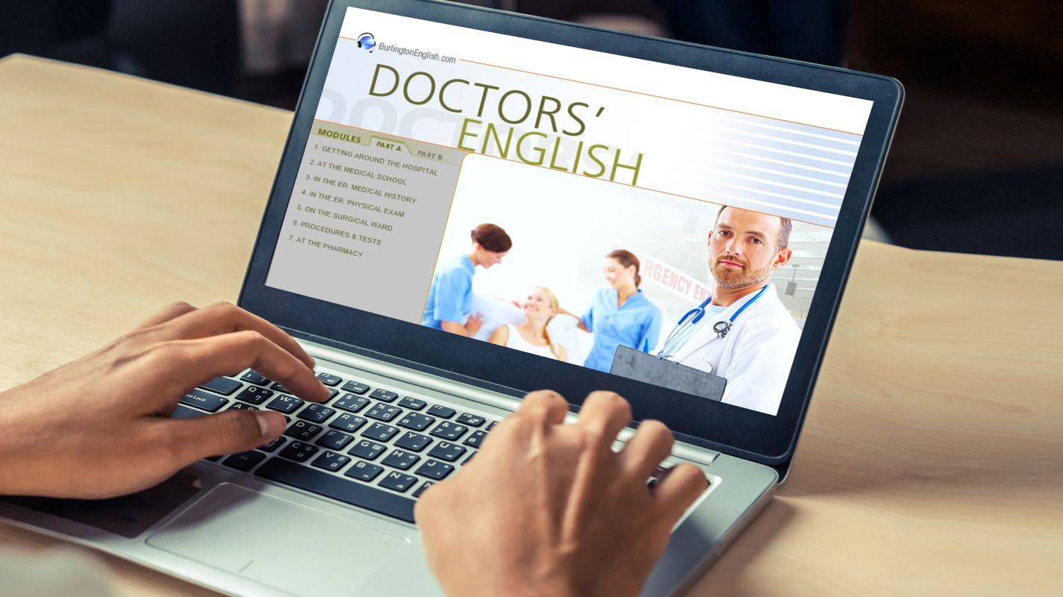
Let Medical Students Become 21st Century Physicians
L.V. YAGENICH

Slide 3
We don’t need no obsolete medical education, sings the average medical student leaning on a fat volume of anatomy. Rightly so, as in the 21st century, students should learn about the human body through virtual reality, should familiarize themselves with digital health, and prepare for the sweeping changes technology brings upon the medical community already in medical school. Let’s reform medical education to nurture 21st century physicians!

Slide 4
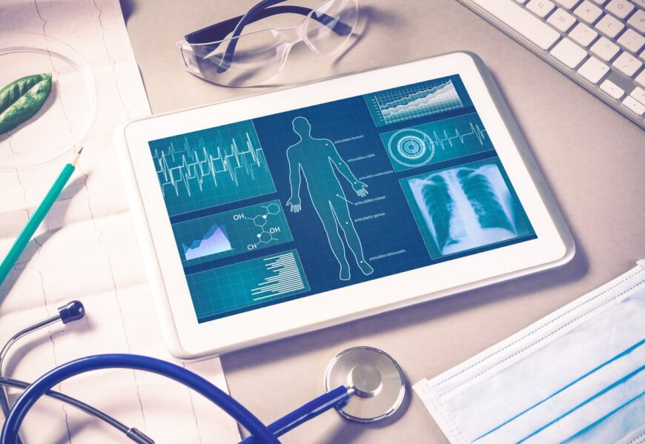
What is the problem with the medical curriculum today?

Slide 5
What should change and how?
Instead of only burying students in libraries with gazillions of books for memorizing data, they should get a chance to acquire proper digital literacy skills and a general overview of digital health too. These latter two will enable them to get the most out of any healthcare system and to become exceptional physicians since I believe it is not enough today to study medicine and grow into a good doctor based on formal studies and experience gained during residency years.

Slide 6
The medical curriculum today does not prepare students for the world they will face when they start practicing medicine. Why?
No training in administration. A big part of a physician’s job is spent with administration which students do not learn in school.
Not teaching essential skills. The world of technology is changing so fast that instead of teaching them how to use certain technologies, we should give them skills so they can make their own assumptions in the future.
Patients are out of sight. Curriculums today do not focus on the needs of patients.
Outdated. In general, the curriculum today is like it was 50 years ago, not much has changed. All the while patients are becoming empowered; the practice of medicine is filled with more and more technologies.
Not encouraging life-long learning. Disruptive technologies start to replace jobs and nobody, even in medicine, is safe without constantly learning and improving. But how would med schools teach this attitude if they are far behind the latest innovations and are not eager to catch up?

Slide 7
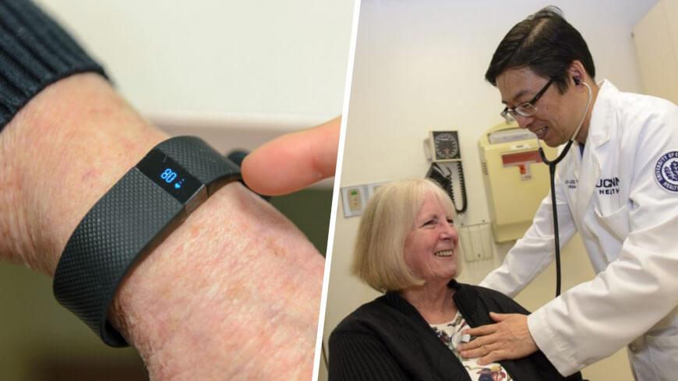

Slide 8
The principles of 21st century medical curriculums:
1) Working with patients alongside technology from day one
Med students should be in close proximity to „real patients” from the start of their studies and learn from their experiences. They’ll be able to better empathize with their sufferings and learn their way of thinking, how they are trying to solve their own health troubles with or without technology. They should also familiarize with the latest technologies very early and see how trackers, wearables, and other digital health gadgets change their own lives. Only if they truly now the latest innovations could they later help patients.
2) Design thinking
Although the approach originates from design, it already spilled over to business life – and I hope soon will be commonplace in healthcare. It is the principle of matching user’s needs with what is technologically feasible and a viable business model. If a doctor has an idea how to improve a treatment method, a drug or patient management with the help of technology, they could make improvements by themselves. Moreover, DYI workshops, such as Makerspaces could even help make things possible.
3) Understanding digital health technologies and the cultural changes they induce
It is of utmost importance to familiarize students with technologies that will shape their medical practice in the coming years. Artificial intelligence, VR/AR, 3D printing, robotics or cheap genome sequencing will all change how we know medicine today. Moreover, the medical professional’s place in the healthcare system, as well as the whole social structure of medicine, will considerably alter soon, and without preparation, newcomers will be swept away by the waves of change.

Slide 9
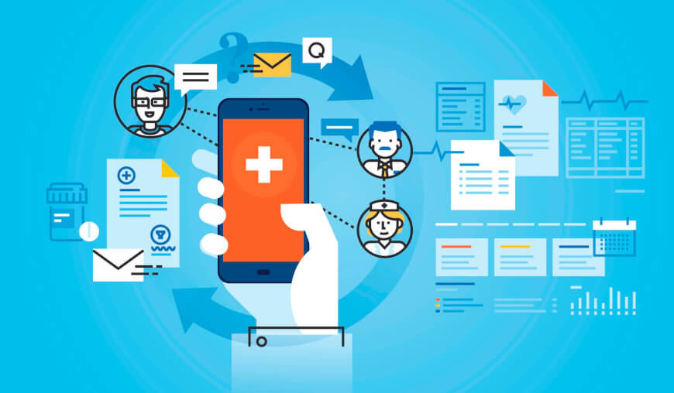

Slide 10
4) Understanding empowered patients
They use health sensors, trackers, get advice and information about their health and condition from curated sources online. They are eager to know more and try out innovations. Empowered patients challenge doctors and expect medical professionals to treat them as equal partners when designing their treatment plans and carry out their therapy. Physicians could learn from them a lot!
5) Dealing with ethical issues due to new technologies
Who will have the responsibility when a machine learning algorithm misses a nodule on a chest X-ray? How far should genome editing methods go in improving babies? Where are the boundaries of private patient data? Plenty of serious ethical questions and concerns arise due to the latest innovations, and it is important for the young generation to think about and discuss all these dilemmas in details.

Slide 11
6) Advanced medical communication coupled with digital literacy
The profession of practicing medicine is based on communication. And as social media and other digital technologies play a major role in today’s communication, digital literacy must be included in the medical curriculum. The value of social media has been demonstrated several times in medicine and healthcare, therefore it is time to prepare medical students for the conditions they will have to face when they graduate.

Slide 12
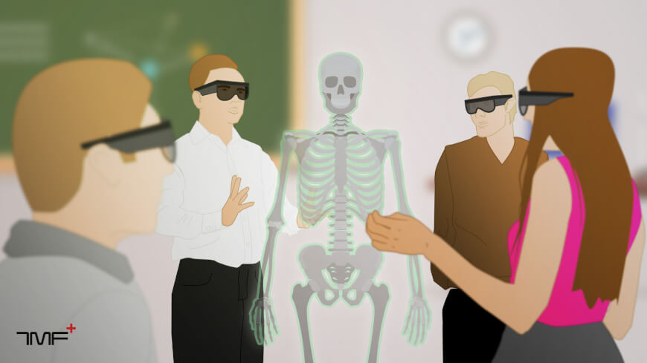
7) Keeping pace with the times: bringing new technologies to medical education

Slide 13
8) Gamification based learning materials
I’m not saying that memorizing information and learning from age-old pearls of wisdom is not a feasible way to get to important medical knowledge. But would you not use gamification methods to make the learning process easier and more effective? Are we not supposed to also have some fun while studying? There are many gamification-based learning materials or knowledge testing sites already out there to break away from traditional studying and motivate more parts of our brains.

Slide 14
9) Professor-student equal-level partnership
As the patient-doctor relationship turns from a hierarchical, asymmetric power relationship into an equal-level partnership, the same could happen with the professor-student rapport. The professor is not the ultimate gatekeeper of definite knowledge; he is also learning from students and incorporates feedback into the curriculum.

Slide 15
“Lessons in Digital Health”
We should discussed telemedicine, communities, information management, health sensors, wearables, genetic testing, privacy issues, ethical concerns, new technologies, and many more. Students had to discuss in groups how they would design the best health sensor or how they would build up a telemedicine application to get the most optimal outcome. They sought some answers what would happen in a hospital if the most innovative technologies were available from one day to another.

Slide 16
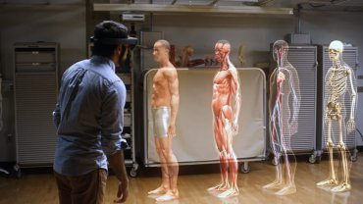
https://medicalfuturist.com/magazine

