Slide 1
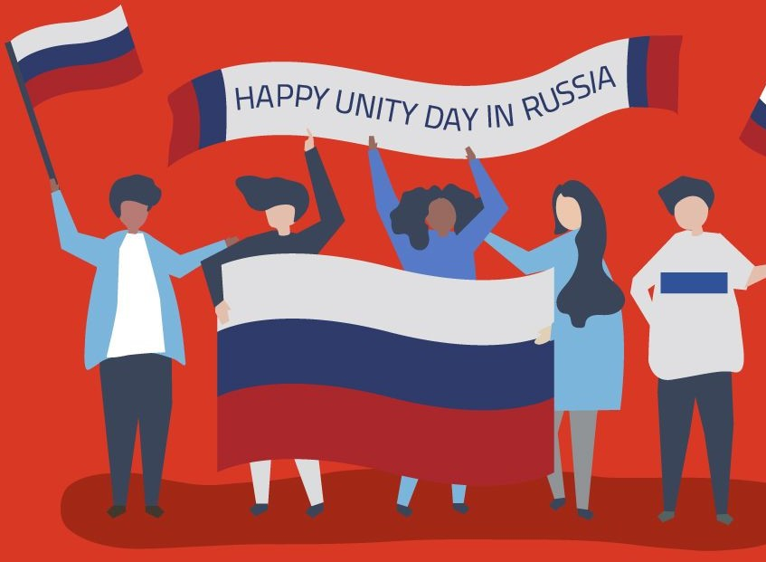
Unity Day in Russia
PREPARED
BY A STUDENT
GROUP L2-201(1)
ALINA YATSENKO

Slide 2
Unity Day calls for tolerance between various ethnic and religious groups in the Russian Federation. However, the holiday’s purpose can at times be misunderstood. Ultranationalists may organize demonstrations on this day, and many others see it as a day off.

Slide 3
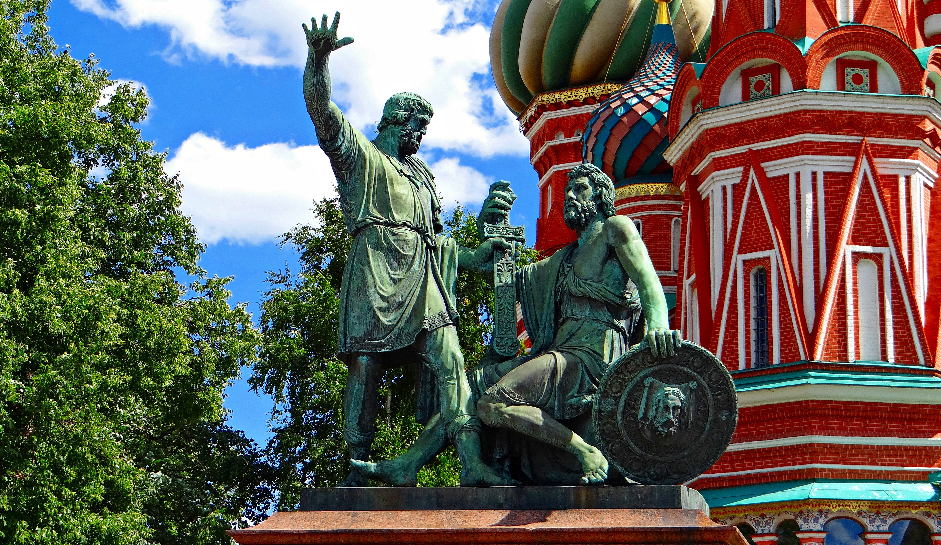
Background
Unity Day commemorates a Russian popular uprising that freed Moscow from Polish-Lithuanian occupation forces on November 4, 1612. Leaders of the uprising, Kuzma Minin and Dmitry Pozharsky, became national heroes. In 1649, Russian Tsar Alexei Mikhailovich made November 4 (October 22 of the then used Julian calendar) a public holiday. Many Russians celebrated this day until 1917. In 1918, the Bolsheviks replaced it with a new holiday, November 7, to commemorate the Revolution of 1917. November 4 once again became a public holiday in 2005, when the Russian Parliament removed November 7 from the list of official public holidays and introduced Unity Day.

Slide 4
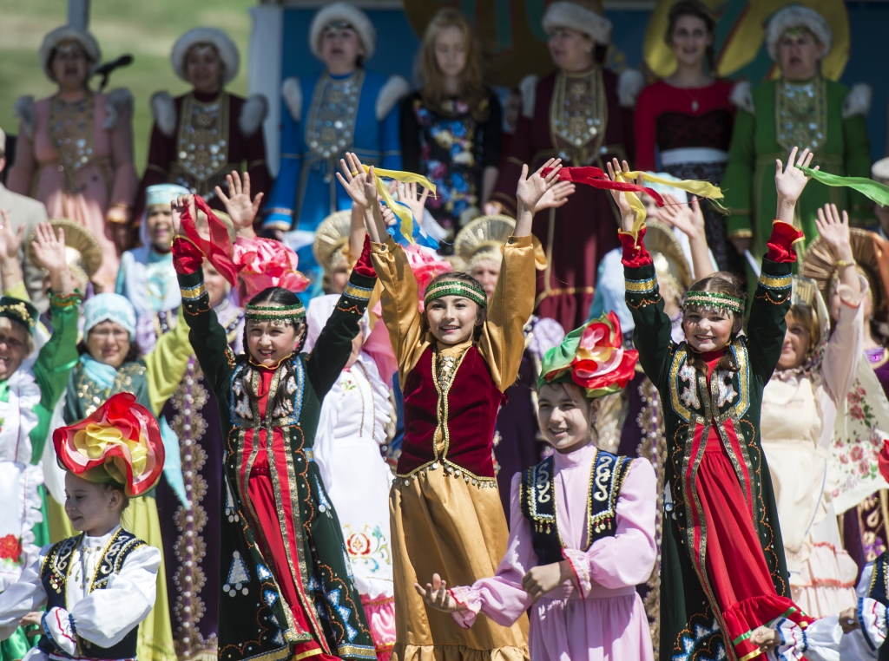
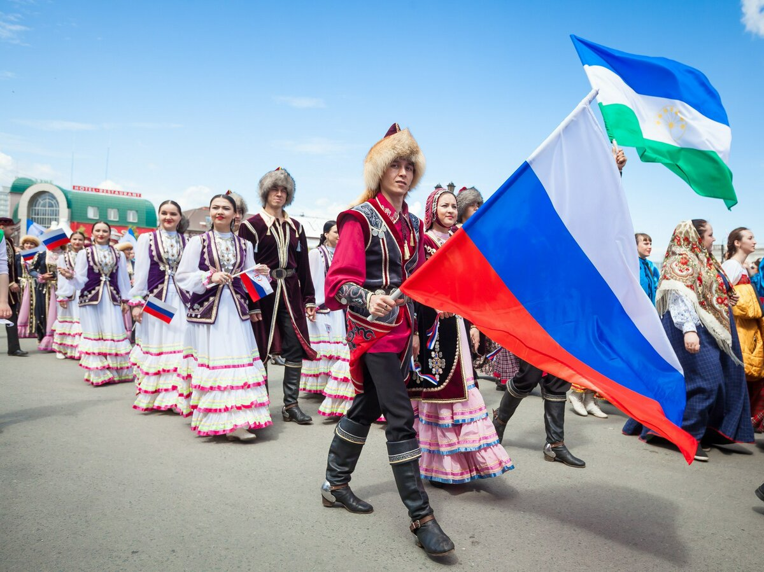
What Do People Do?
Russians may celebrate Unity Day in many ways. Some may lay flowers to the monuments of national heroes, Kuzma Minin and Dmitry Pozharsky.
Concerts and exhibitions take place on this day.

Slide 5
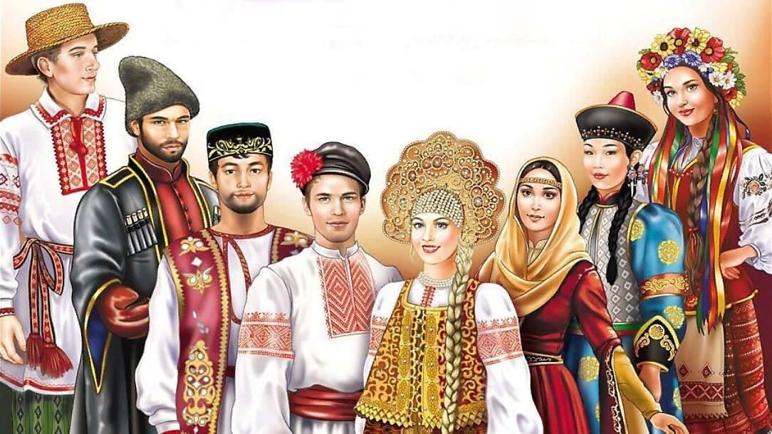
Public Life
November 4 is a public holiday in the Russian Federation. Schools, post offices, public buildings and most businesses are closed on this day. If November 4 falls on a weekend, the public holiday usually moves to the following Monday.

Slide 6
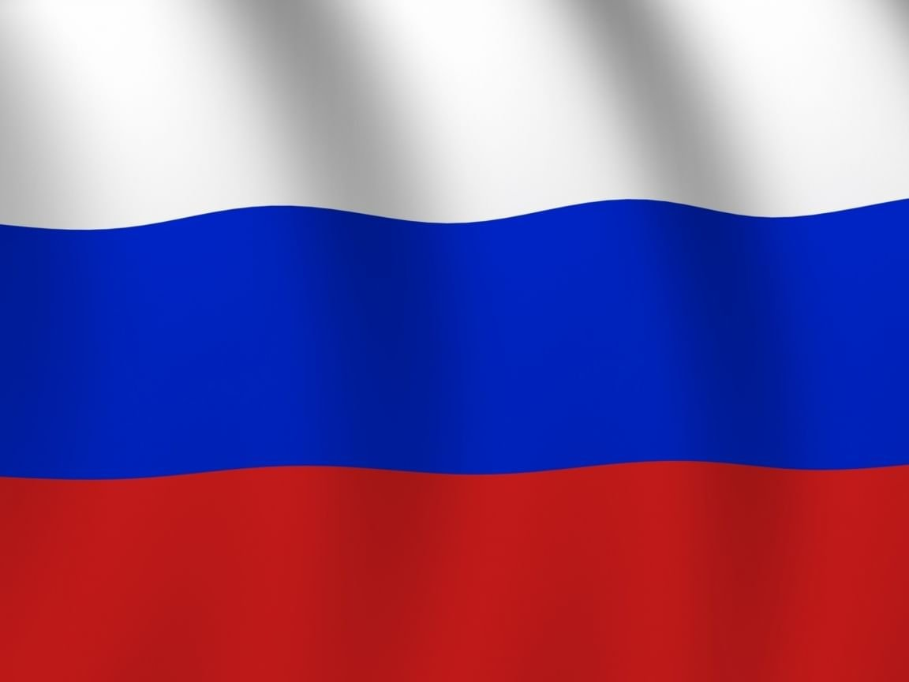
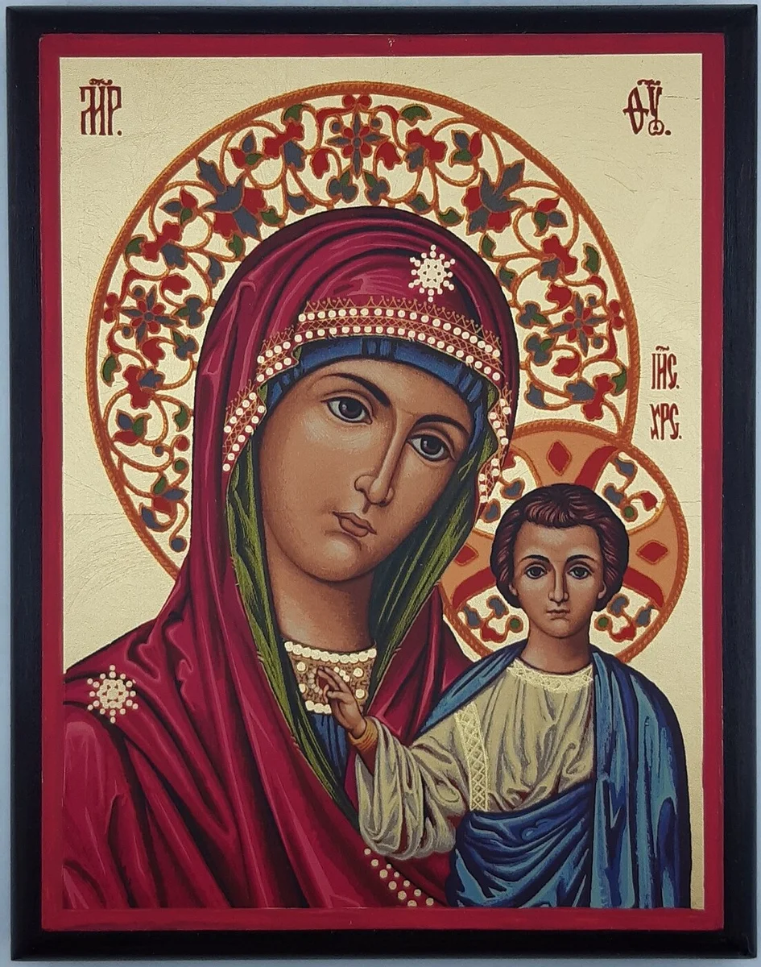
Symbols
Monuments dedicated to Minin and Pozharsky, Our Lady of Kazan icon and the Russian flag are the most common symbols of Unity Day in Russia.

Slide 7
Thanks for your attention

