Slide 1
National Unity Day
Prepared: Kravchenko Kristina,
Prasolova Anna. Group P203(1)

Slide 2
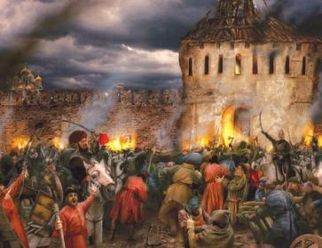
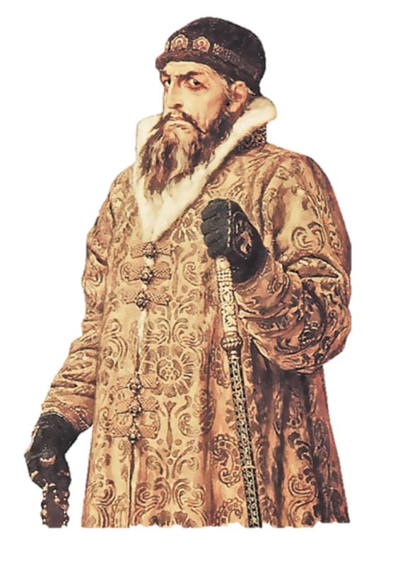
The history of the holiday
The beginning of the XVII century in the history of our state is called the Time of Troubles. One of the reasons for the turmoil was the suppression of the legitimate Moscow dynasty of the Rurikovich. This coincided with the devastation, famine, which were the result of the unreasonable policy of Ivan Grozny.

Slide 3
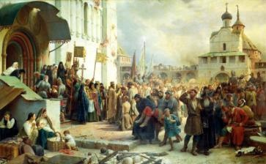
In an effort to overcome economic ruin, the authorities have tightened policy, increased taxes. That was the reason for people's. There were contradictions between the boyars and the nobles. All this has led to the weakening of the central government.

Slide 4
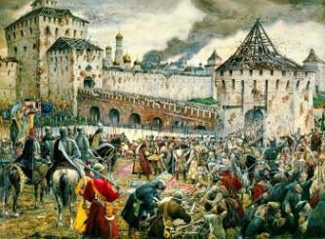
Since September 1610, Moscow has been occupied by Polish troops. The real power in the Russian capital was possessed by Polish military leaders. The invaders plundered the population, burned towns and villages, killed or captured residents. It was about preserving national identity and independence.

Slide 5
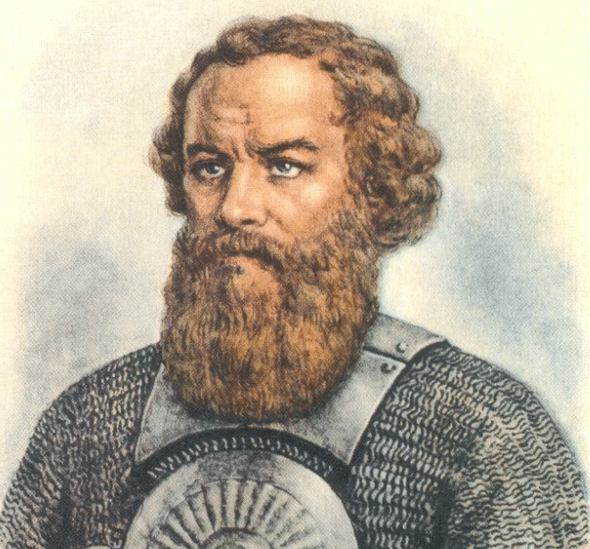
The realization of this fact led to the awakening of the Russian people. They rose up to fight for the liberation of the fatherland. The headmaster Kuzma Minin from elective district council of Nizhny Novgorod applied to the local residents with an appeal to help by all means in creating a new people's militia to liberate Russia from foreign invaders.

Slide 6
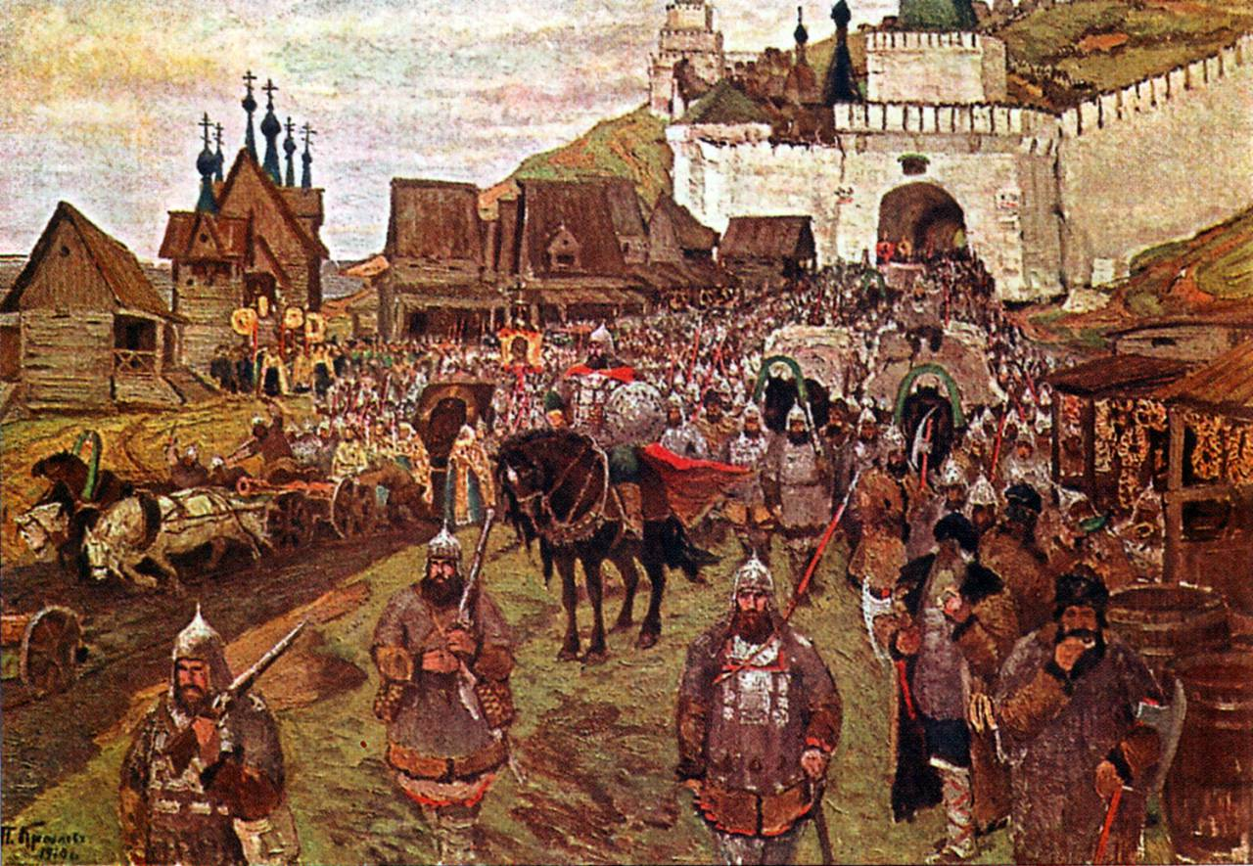
In July 1612, the militia marched on Moscow. The participants of the assault demonstrated a model of heroism, unity of the whole people, regardless of origin, religion, position in society.

Slide 7
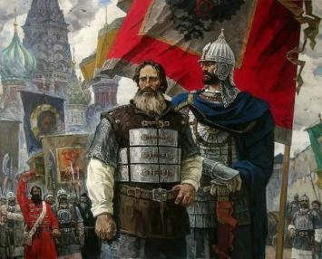
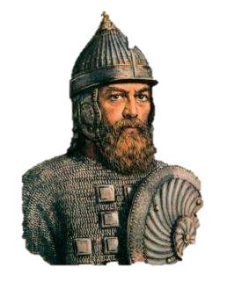
On November 4, in 1612, the militia of Minin and Pozharsky completely liberated the capital from enemies. That is why the day of November 4 is recognized as the Unity Day.

Slide 8
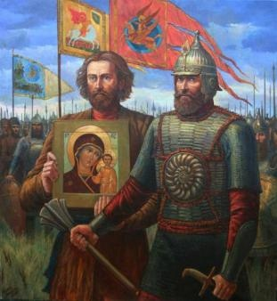
A miraculous image of the Most Holy Theotokos was sent from Kazan to the militia headed by Prince Pozharsky. November 4 is a double holiday for Russia: National Unity Day and the celebration in honor of the Kazan Icon of the Most Holy Theotokos

Slide 9
Thank you for your attention!

