Slide 1
Medical Academy named after S.I. Georgievsky of Vernadsky CFU National unity day
Students Veronica Smirnova
Sabina Adjaripova
Group P-S-O205(1)

Slide 2
What is National Unity Day?
Unity Day is a national holiday in Russia held on November 4 (October 22, Old Style). It commemorates the popular uprising which expelled Polish–Lithuanian occupation forces from Moscow in November 1612, and more generally the end of the Time of Troubles and turning point of the Polish-Russian War (1605–1618). When two people Minin and Pozharsky led the militia and with the help of liberated Moscow from the enemies.

Slide 3
Russia is a multinational country and to solve difficult situations all must unite. This date is to forget about the contradictions and disagreements, that cause conflicts. 4 November is a holiday, which makes it clear to the people, that we should be kind to each other, because all the nations living on the territory of our country are closely interrelated.
To ensure that all have felt good attitude to each other a variety of events across the country. Themed presentation, festivities, Exhibition of Folk Art, concerts and culminates with fireworks.

Slide 4
Why exactly 4 November?
The decision to choose the name and date of the holiday was made at the highest level. Russian Patriarch offered to make the National Unity Day holiday the initiated events Time of Troubles. At the time, Moscow was in a state of siege. With Kozma Minin and Prince Dmitry Pozharsky organized militia, and with its help liberated Moscow from strangers.4 November 1649 , became an official state holiday, and to 1917 year, this date was special for all Russian people.
In the Soviet times, there was a feast 7 November. October Revolution Day was celebrated always with the scale of the whole country. After the collapse of the USSR the holiday by inertia continued to celebrate as this date remained the official holiday on the calendar. WITH 1996 year holiday called the Day of Accord and Reconciliation. AT 2004 by order of the President of Russia introduced a new National Unity Day holiday.

Slide 5
History
In the early 1600’s, Poland and Lithuania united under a single government and took advantage of the weakness of the state of Muscovy (Russia). They conquered most of Russia and even took Moscow. They had a dream of unifying the northern Slavs under a single state, but the Russian people demanded their independence. On November 4th, 1612, which was actually October 22nd on the calendar used at the time, Russians in Moscow revolted and drove out the invaders. All economic and social strata of Russian society united behind the effort even without any Czar to lead them.

Slide 6
The two main leaders of the revolt were Dmitry Pozharsky and Kuzma Minin, both of whom are today considered to be Russian national heroes. The new Czar who took the throne of Russia after the revolt, Mikhail Romanov, declared a holiday with the long title “Day of Moscow’s Liberation From Polish Invaders.” In 1649, Czar Alexei Mikhailovich declared November 4th an official public holiday, which continued to be celebrated until the Bolshevik Revolution in 1918. At that time, the new Communist government eliminated the holiday and replaced it with the November 7th remembrance of the Bolshevik Revolution. In 2005, about a decade and a half after the fall of the USSR, November 7th was eliminated and November 4th reinstated as a national holiday, this time called “National Unity Day”.

Slide 7
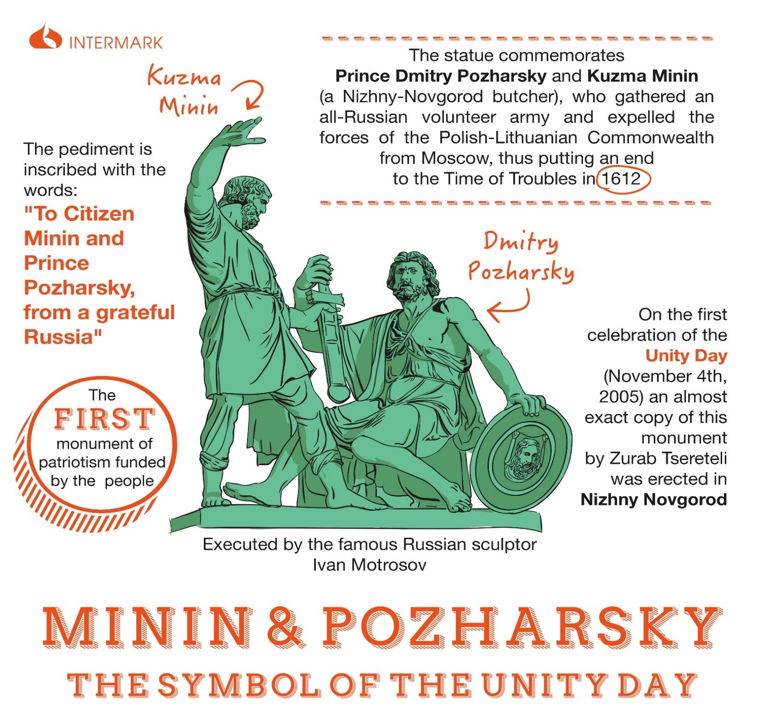

Slide 8
National Unity Day Traditions
In Russia, the Day of National Unity isn’t met with a lot of celebrations, likely because of how new it is.
The biggest celebration for the Day of National Unity in Russia is the festive ceremony at the Grand Kremlin Palace . Some of Russia’s highest-ranking members of society are invited to attend. These include the Patriarch of Moscow, His Holiness Kirill I, government representatives, and people in the fields of culture and science.
The President of Russia also offers awards to people who have benefited the country in some way. In particular, those who have contributed to the country’s peace and unity in a big way or have aided the country in its relations with other nations are considered highly valued members of society.

Slide 9
On the side of the general population, people may host a fair, festival. There may also be a military parade, in larger cities. In addition, flowers are laid at national monuments and services are given.
Some may lay flowers to the monuments of national heroes, Kuzma Minin and Dmitry Pozharsky, who led a popular uprising that freed Moscow from occupation forces on November 4, 1612.
Russian Orthodox Christians may attend a church service to honor Our Lady of Kazan, one of the most important Russian Orthodox icons. November 4 is this icon’s feast day. The church service usually ends with a procession. Many politicians, public and religious figures stress in televised addresses the need for unity of all ethnic and religious groups in the Russian Federation. Concerts and exhibitions take place on this day.
However, for many Russians, November 4 is just another day off or a substitute for a holiday that was held on November 7 in the Soviet times. Yet others may see it as a call for unity of ethnic Russians against non-Russians. Some ultranationalists and neo-Nazis may have demonstrations on this day.

Slide 10
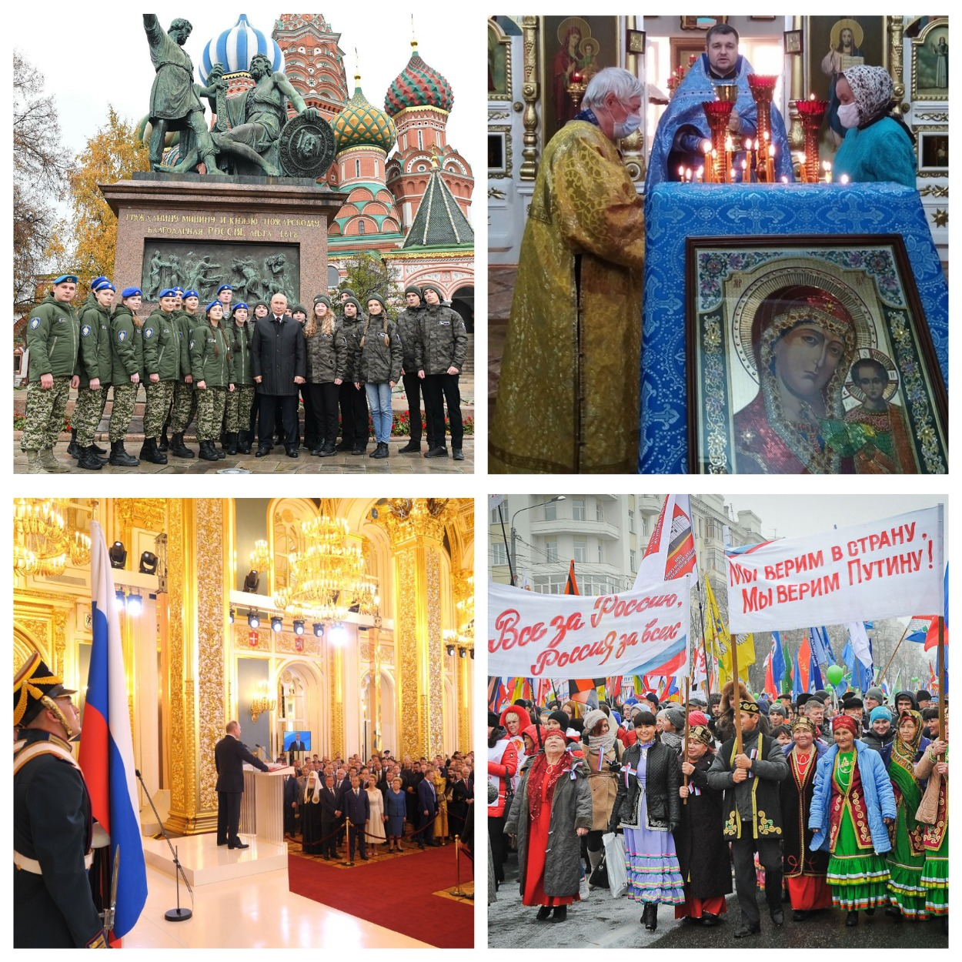

Slide 11
Public Life
November 4 is a public holiday in the Russian Federation. Schools, post offices, public buildings and most businesses are closed on this day. Public transport schedules may vary due to religious processions and political demonstrations. If November 4 falls on a weekend, the public holiday usually moves to the following Monday. For many Russians, November 4 is just another day off.

Slide 12
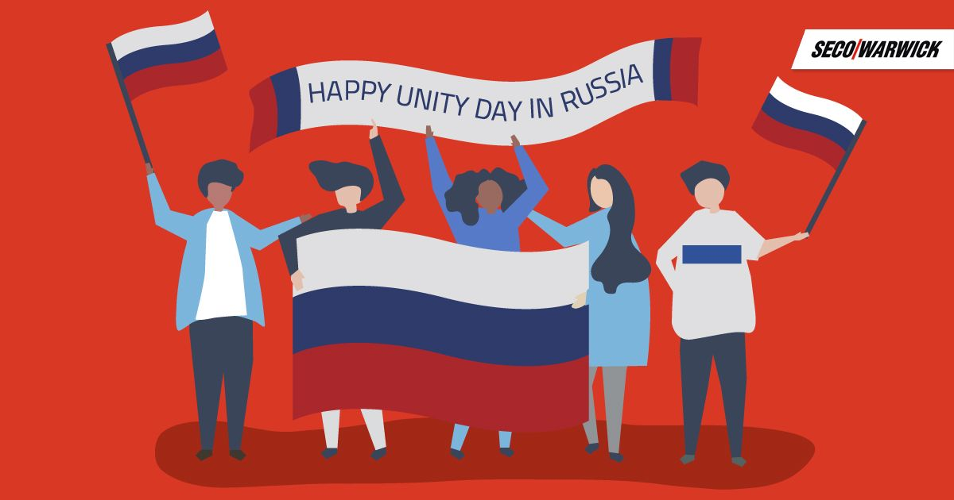

Slide 13
Symbols
Monuments dedicated to Minin and Pozharsky, Our Lady of Kazan icon and the Russian flag are the most common symbols of Unity Day in Russia.

Slide 14
Symbols

Slide 15
A Shared Holiday
The Day of National Unity in Russia shares its date with another important holiday. It’s called the Feast of Kazan Icon of the Mother of God. Kuzma Minin and Dmitry Pozharsky prayed to this icon and took it with them on their march. Each year, the churches do a special service dedicated to the Kazan icon.

Slide 16
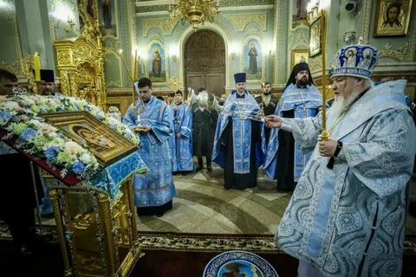

Slide 17
Meaning to nation
The Day of National Unity symbolizes the solidarity and unity of the Russian people, ensuring the country's well-being and prosperity.
And today peace, cohesion and harmony between the citizens of Russia of all nationalities, political and religious views are able to perform a miracle and lead Russia to power and prosperity.
This is a wonderful and very necessary holiday. At all times, our country faces serious problems, powerful enemies and dangers. To resist them, unity and cohesion are needed, and a force capable of instilling the will to win in the hearts of the people is needed. Then the people will be able to crush all obstacles and overcome difficulties.

Slide 18
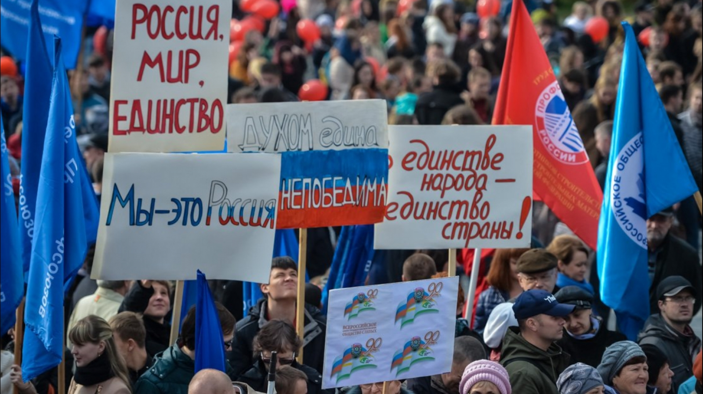

Slide 19
Even the epidemiological situation in the country and the restrictions due to the coronavirus will not prevent us from celebrating it.
Happy holiday!!! Happy National Unity Day!!!

