Slide 1
National
Unity Day

Slide 2
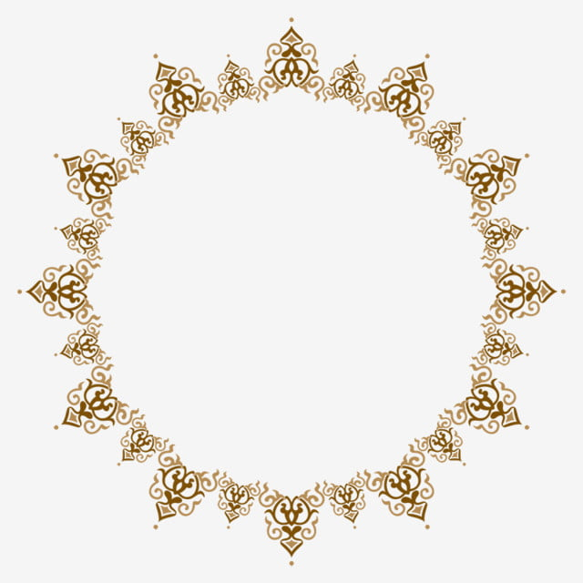
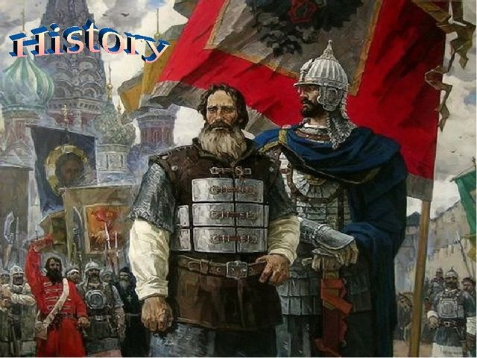
The day's name alludes to the idea that all classes of Russian society united to preserve Russian statehood when there was neither a tsar nor a patriarch to guide them. In 1613 tsar Mikhail Romanov instituted a holiday named Day of Moscow’s Liberation from Polish Invaders.
It was celebrated in the Russian Empire until 1917, when it was replaced with a commemoration of the Russian Revolution. Unity Day was reinstituted by the Russian Federation in 2005, when the events of the year 1612 have been celebrated instead of those of 1917 every November 4 since. The day is also the feast day of the Russian Orthodox icon of Our Lady of Kazan.

Slide 3
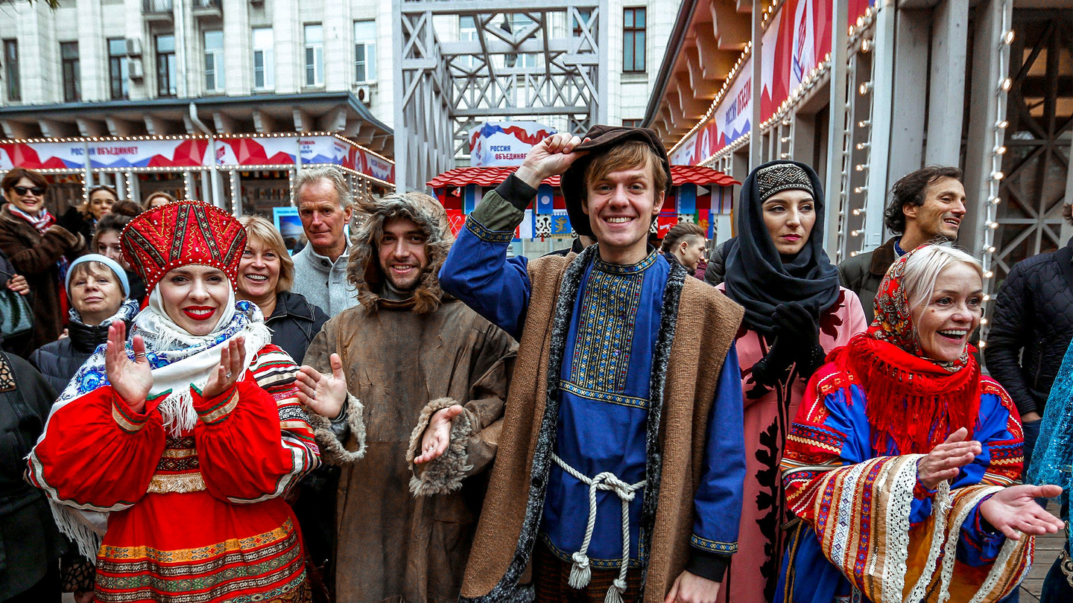
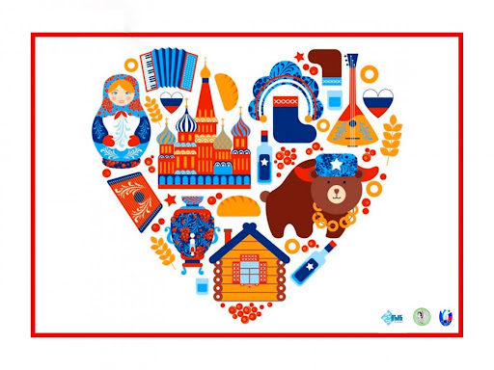
In the Soviet years, November 4 was not celebrated and was not a day off. November 7, the Day of the Great October Socialist Revolution, was considered a festive day. In 1996, the holiday was renamed the Day of Reconciliation and Accord.
In September 2004, the Interreligious Council of Russia made November 4 a holiday and celebrated it as the Day of National Unity. The State Duma supported the initiative. This day became a day off instead of November 7, which received the status of a memorable date - the Day of the October Revolution of 1917

Slide 4
Why is the holiday called National Unity Day?
One of the explanations for why such a name was chosen may be an explanatory note to the draft law on the introduction of a new holiday: "On November 4, 1612, the soldiers of the people's militia ... demonstrated an example of heroism and solidarity of the whole people, regardless of origin, religion and position in society."

Slide 5
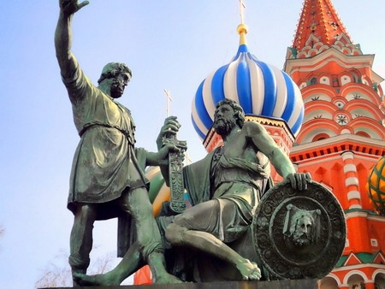
Russians may celebrate Unity Day in many ways. Some may lay flowers to the monuments of national heroes, Kuzma Minin and Dmitry Pozharsky, who led a popular uprising that freed Moscow from occupation forces on November 4, 1612
However, for many Russians, November 4 is just another day off or a substitute for a holiday that was held on November 7 in the Soviet times. Yet others may see it as a call for unity of ethnic Russians against non-Russians. Some ultranationalists and neo-Nazis may have demonstrations on this day.

Slide 6
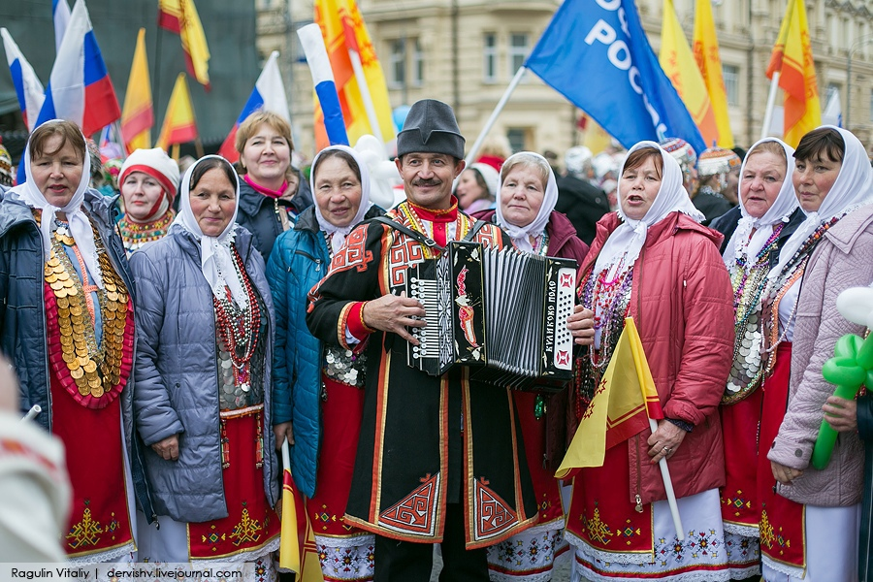
Public Life
November 4 is a public holiday in the Russian Federation. Schools, post offices, public buildings and most businesses are closed on this day. Public transport schedules may vary due to religious processions and political demonstrations. If November 4 falls on a weekend, the public holiday usually moves to the following Monday.

Slide 7
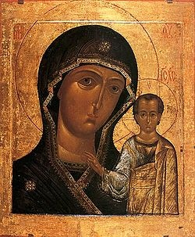
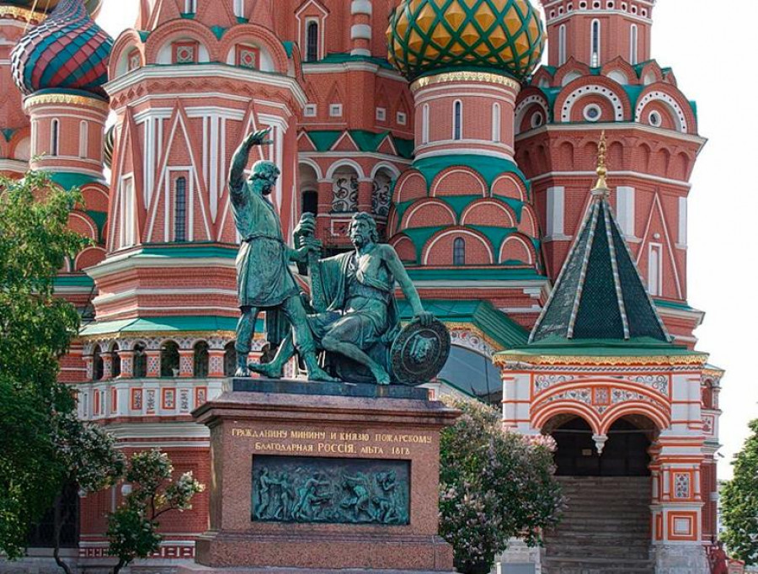
Symbols
Monuments dedicated to Minin and Pozharsky, Our Lady of Kazan icon and the Russian flag are the most common symbols of Unity Day in Russia.
According to legend, the Kazan Icon of the Mother of God was sent from Kazan to Prince Dmitry Pozharsky and became the patroness of the people's militia. With her, the army entered Moscow.

Slide 8
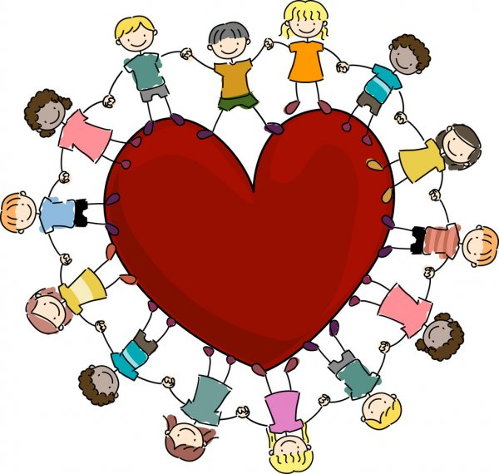
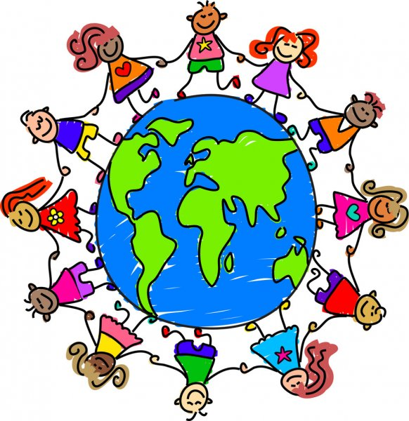
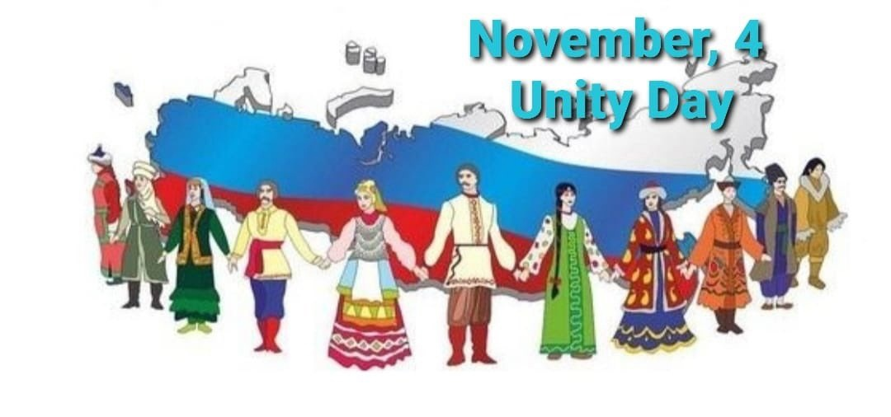
Thank you for the attention!♥
The presentation was prepared by:
Aliye Velieva & Elvina Chabanasan
♥ Pediatricians 205 (1) ♥

