Slide 1
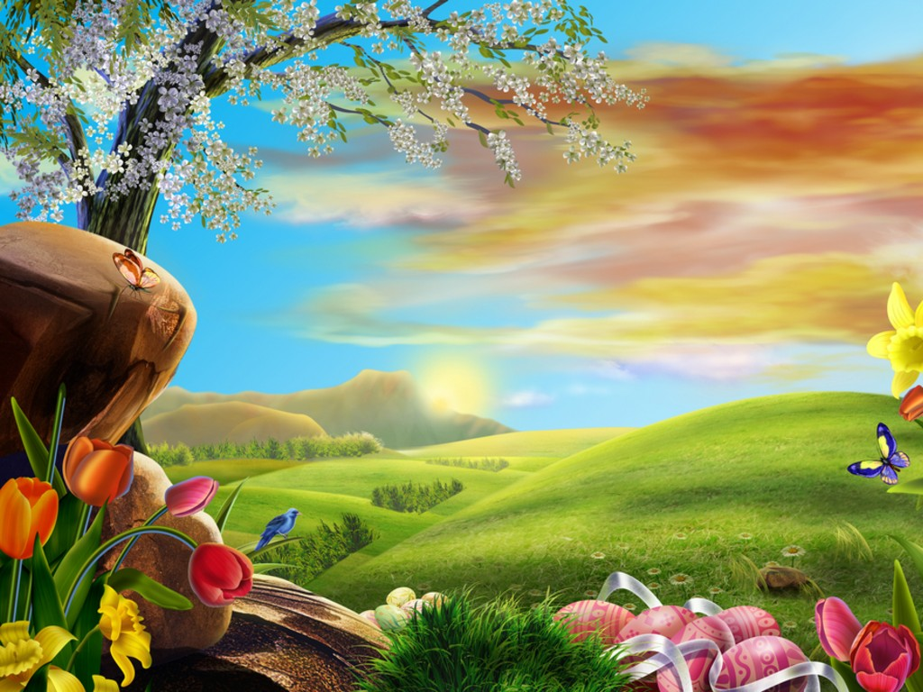
Easter

Slide 2
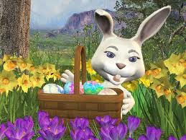
Easter is celebrated every spring. It is always celebrated on a Sunday. Easter has its roots in many traditions gathered from many parts of the globe.

Slide 3
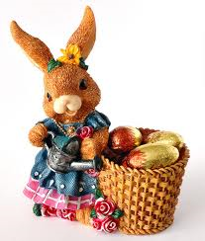
There are many symbols of Easter. German settlers to Pennsylvania brought with them the story of the Easter Bunny. Children believed that if they were good, the Easter Bunny would lay a nest of colored eggs. Because rabbits are known for producing a lot of young, especially in the springtime, they symbolize new life. As the Easter Bunny custom spread across the country, it led to other traditions such as Easter baskets and gift giving.

Slide 4
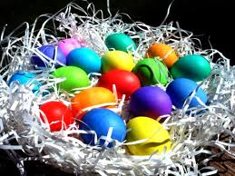
Birds lay a great number of colorful eggs in the spring which has brought about the use of Easter eggs, egg dyeing and egg hunts. Long ago, the egg was honored during many springtime festivals. Egg dyeing was popular in ancient times and continues to be popular today. To the Christian, the egg represents the rebirth of the earth and of man.

Slide 5
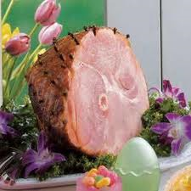
Ham is the traditional food of Easter. This type of pork is popular throughout the world. In many cultures, the pig is a symbol of prosperity.

Slide 6
