Slide 1
Teaching Prosody of Public Speaking to Non-majors
Elena Kryukova, national research university higher school of economics

Slide 2
Why teach pronunciation to non-majors?
Problems:
Tend to underestimate the communicative value of suprasegmental features: rhythm, pausing, stress and tone
May lack confidence when speaking English and fear that their speech is accented
Their accent can affect intelligibility and overall impression
Had no or limited pronunciation training
Aims:
Raise awareness of suprasegmental phonological features
Improve self-esteem
Learn to analyze and assess performances
Practice
Increase motivation for self-study and further training

Slide 3
Why is prosody important?
Prosody is the rhythm and intonation of a language.
In English, rhythmic and melodic signals serve as “road signs” to help the listener follow the intentions of the speaker. These signals communicate emphasis and make clear the relationship between ideas so that listeners can readily identify these relationships and understand the speaker’s meaning.
Gilbert, J.B. (2008)

Slide 4
Competences for oral presentations
Phonological
Intelligibility
fluency
Linguistic and discourse
Lexis, grammar
Cohesion
coherence
Pragmatic
Context
audience
Strategies
Body language
Control/speed
Visual support

Slide 5
Challenges of pronunciation teaching
Discouraging experience (e.g. drilling of isolated sounds)
Psychological barrier
Choice of content
‘if the goal of pronunciation teaching is to help students become more understandable ,… then …it should include a stronger emphasis on prosody’
Derwig, Rossiter, 2003

Slide 6
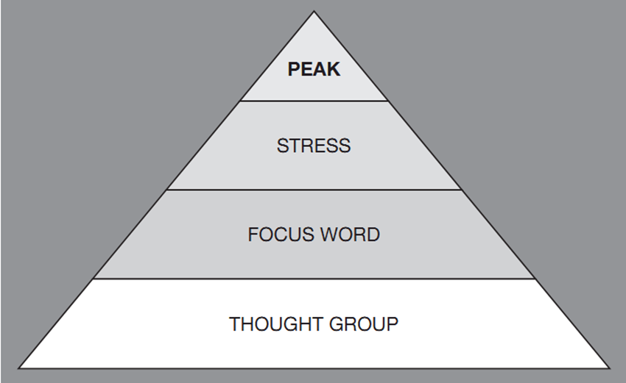
The Prosody Pyramid, Gilbert J. B. (2008)

Slide 8
Spoken academic discourse: a scoring sheet
General assessment of speech
Detailed assessment of speech
SAD | 1 (very ineffective) | 2 | 3 | 4 | 5 (very effective)
Clarity | 1 (unintelligible) | 2 | 3 | 4 | 5 (very intelligible)
Fluency | 1 (not fluent) | 2 | 3 | 4 | 5 (very fluent)
Strategy | 1 (ineffective) | 2 | 3 | 4 | 5 (effective)
Thought group marking | 1 (very weak) | 2 | 3 | 4 | 5 (very strong)
Peak syllable stress | 1 | 2 | 3 | 4 | 5
Word Stress | 1 | 2 | 3 | 4 | 5
Rhythm | 1 | 2 | 3 | 4 | 5

Slide 9
Proposed set of activities:
Presenting relevant suprasegmental features with the Prosody Pyramid
Assessing Spoken Academic Discourse
Practice exercises: defining relevant features in model sentences and texts
Preparing a short oral presentation
Presenting and peer assessment in groups

Slide 10
Projected outcomes
Raised awareness of supersegmental features
Increased motivation for self-study and further training
Improved self-esteem

Slide 11
References
Beth E. Sheppard, Nancy C. Elliott, Melissa M. Baese-Berk (2017) Comprehensibility and intelligibility of international student speech: Comparing perceptions of university EAP instructors and content faculty. Journal of English for Academic Purposes, Volume 26, March 2017, 42-51
Derwing, T. M., & Rossiter, M. (2003). The effects of pronunciation instruction on the accuracy,
fluency, and complexity of L2 accented speech. Applied Language Learning, 13, 1–17.
Gilbert, J.B. (2008) Teaching Pronunciation. Using the Prosody Pyramid. Cambridge: CUP.
Kissling, Elizabeth M., "Teaching Pronunciation: Is Explicit Phonetics Instruction Beneficial for FL Learners?" (2013). Latin American, Latino and Iberian Studies Faculty Publications. 8.

Slide 12
Thank you

