Slide 1
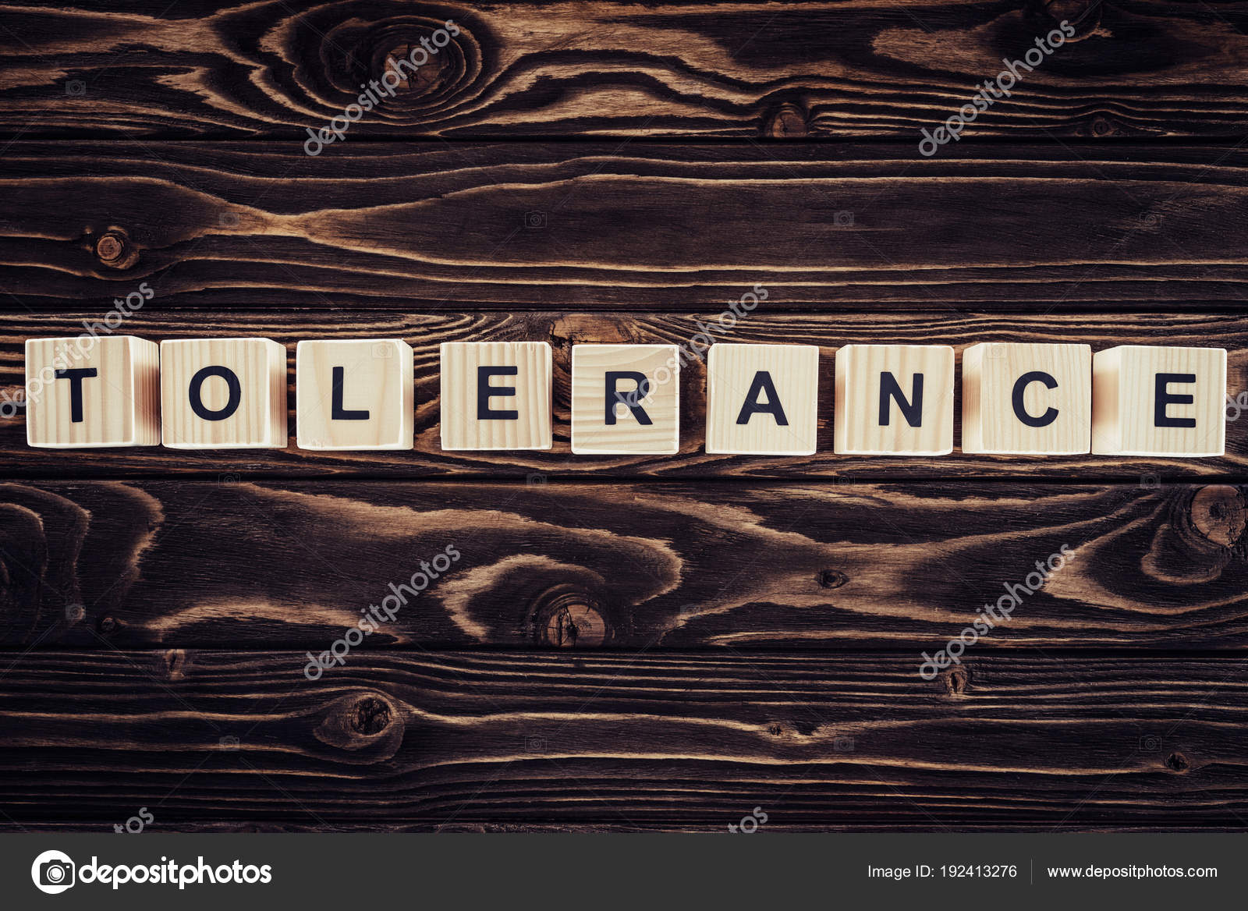
Подготовила Ерофеева Ангелина
183А- группа

Slide 2
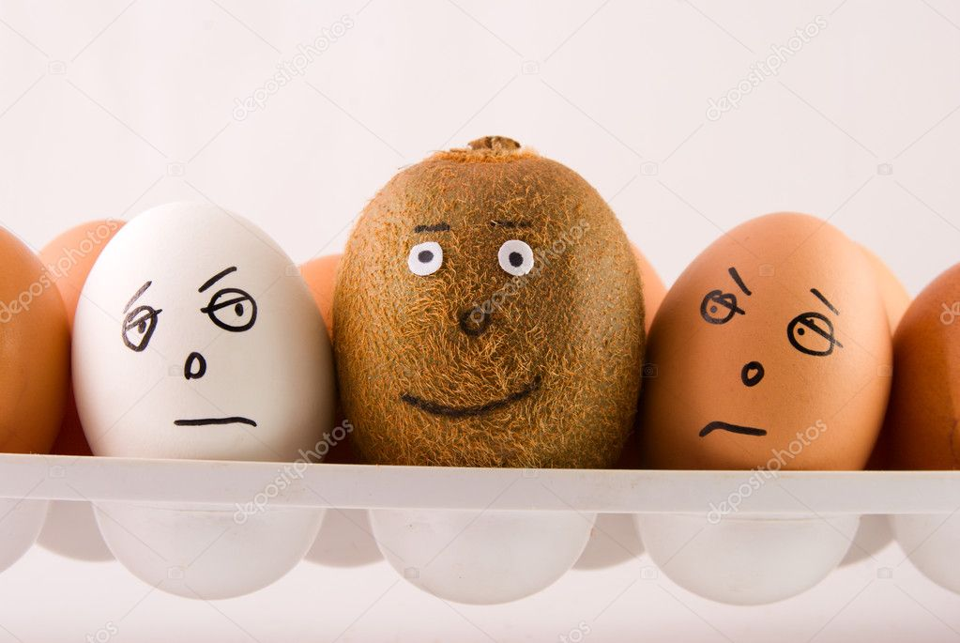
Every person must have moral principles; without them, a person is not a person

Slide 3
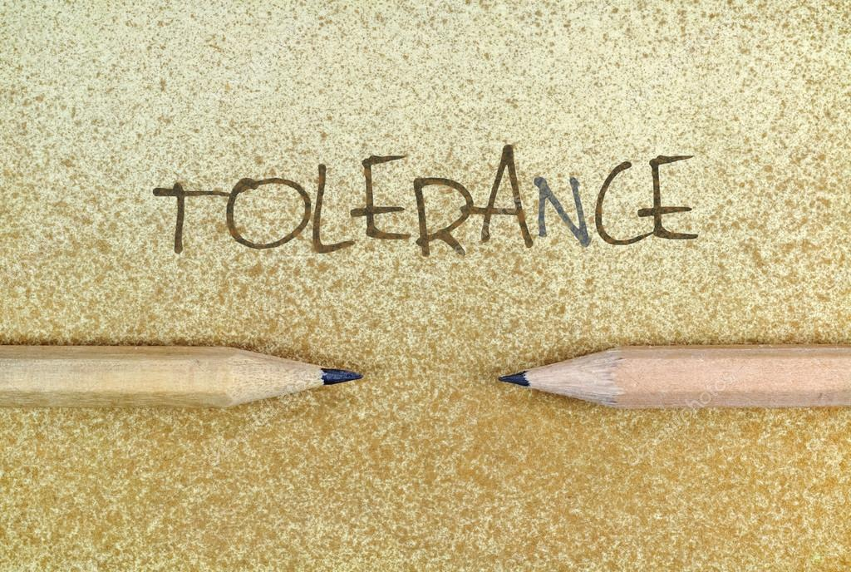
These principles include human morality, nobility, ambition, generosity, and, of course, a person must be tolerant.

Slide 4
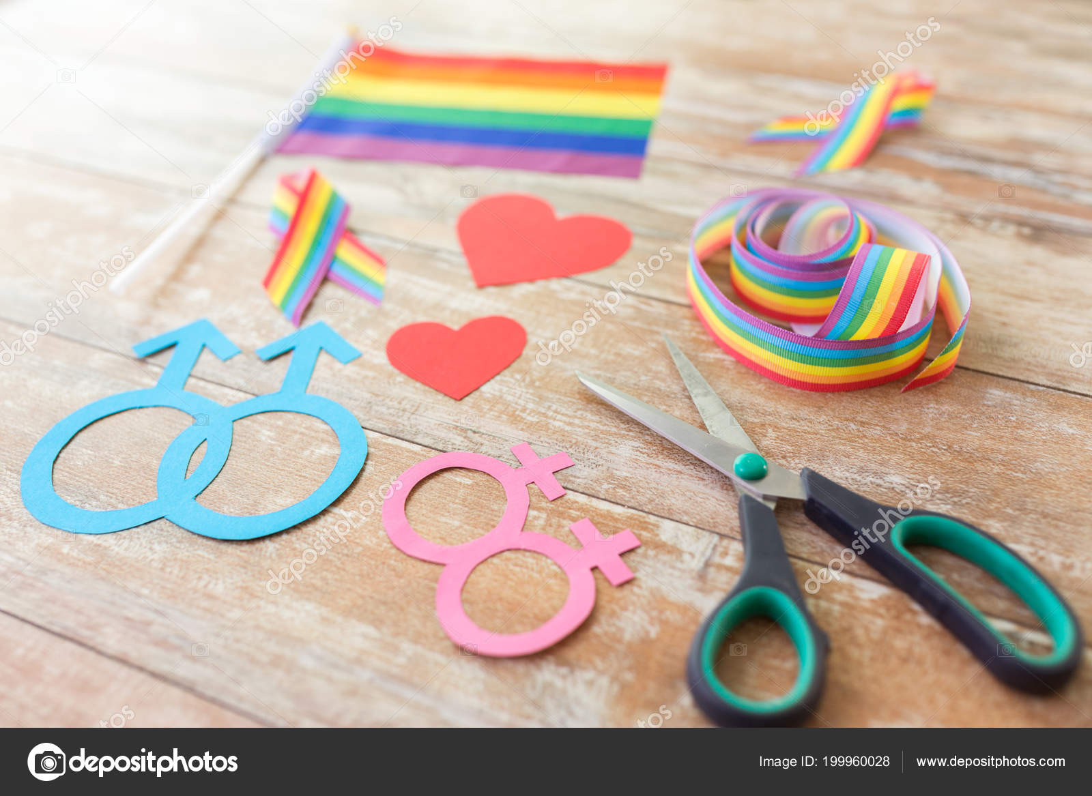
What is tolerance? Tolerance is a person’s tolerance for something else, for example, for a different nationality, faith, other behavior, other customs. If a person has tolerance, then he is a noble person.

Slide 5
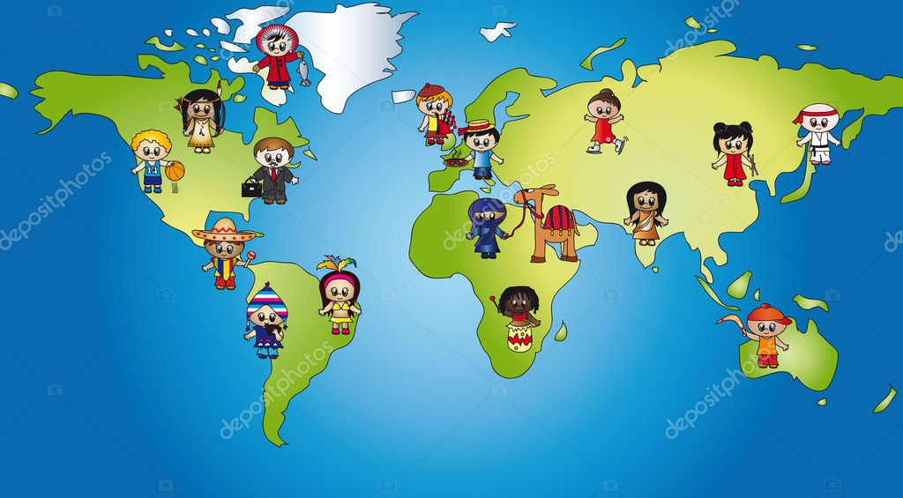
Tolerance is manifested when a person is ready to help anyone, whether he is a ragged man, or the owner of a different skin color, or his faith is different from your faith. Also, tolerance is manifested when you see people's flaws, but do not start criticizing them loudly, so that this does not lead to scandal. Tolerance is manifested in respect for the people around you, for example, you see an elderly man who stands at the door of the store for a long time and cannot open it.

Slide 6
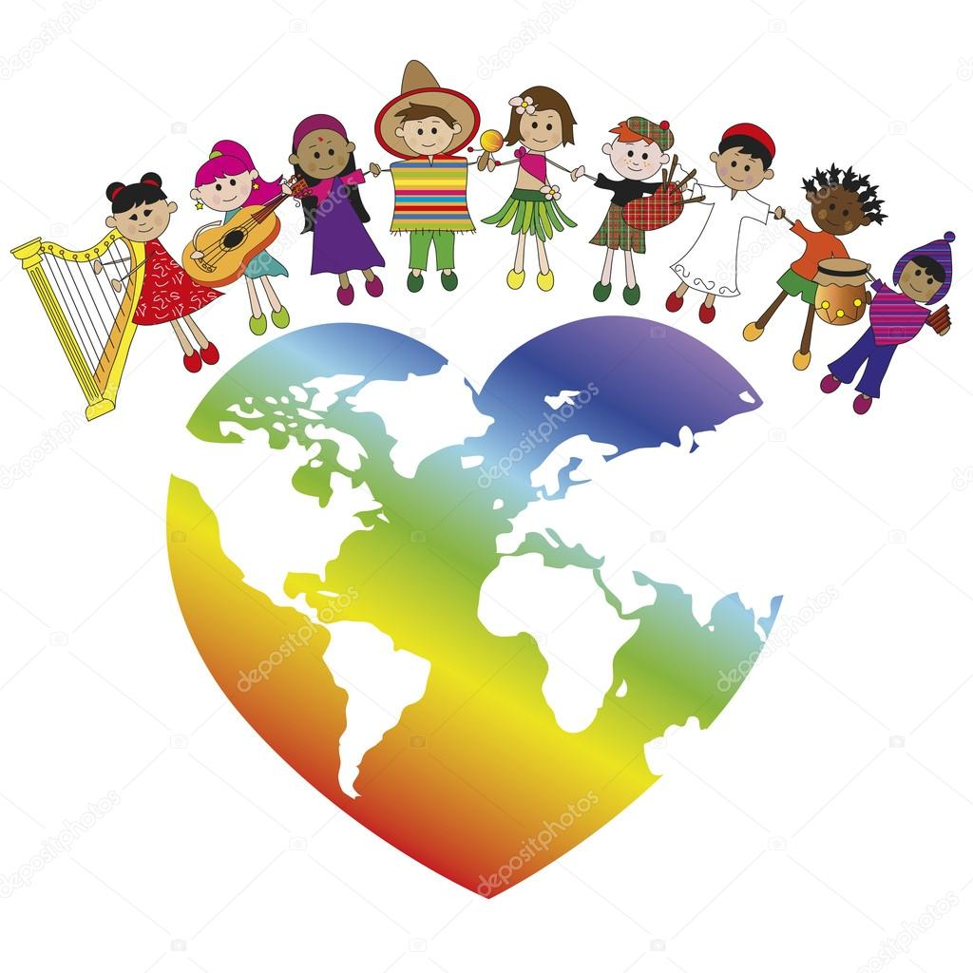
Even during the war, people showed tolerance towards each other, many residents of cities and villages were left without a roof over their heads, but people of other nationalities shared their shelter with them.

Slide 7
Tolerance is needed in order for society to be in order, there will be no violence with tolerance. Thanks to tolerance there will be peace on earth, and if there will be peace on earth, then there will be no war, then people will be happy.

Slide 8
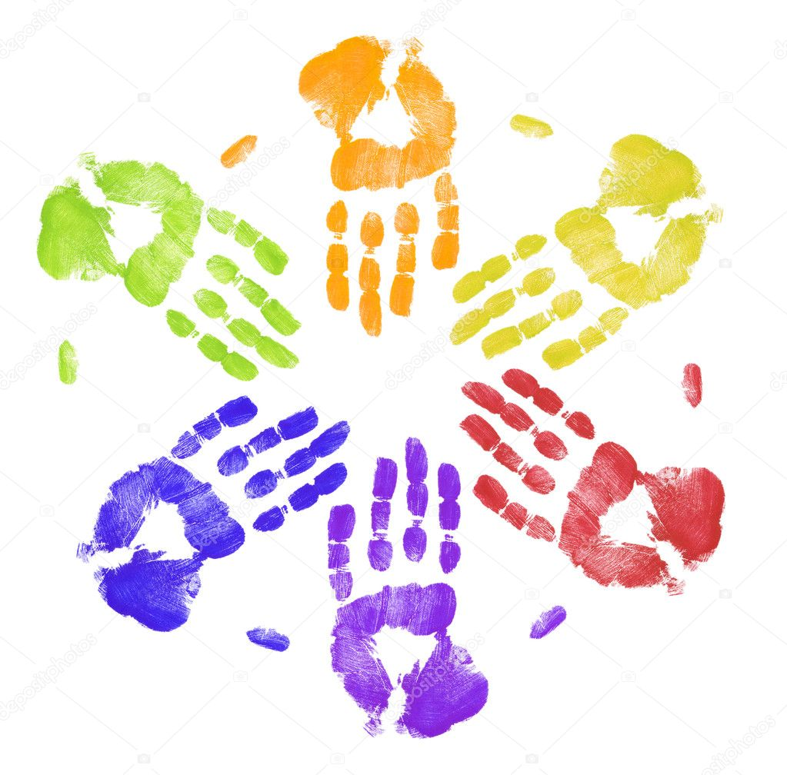
Every day we are faced with the choice to show tolerance towards another person or not.

Slide 9
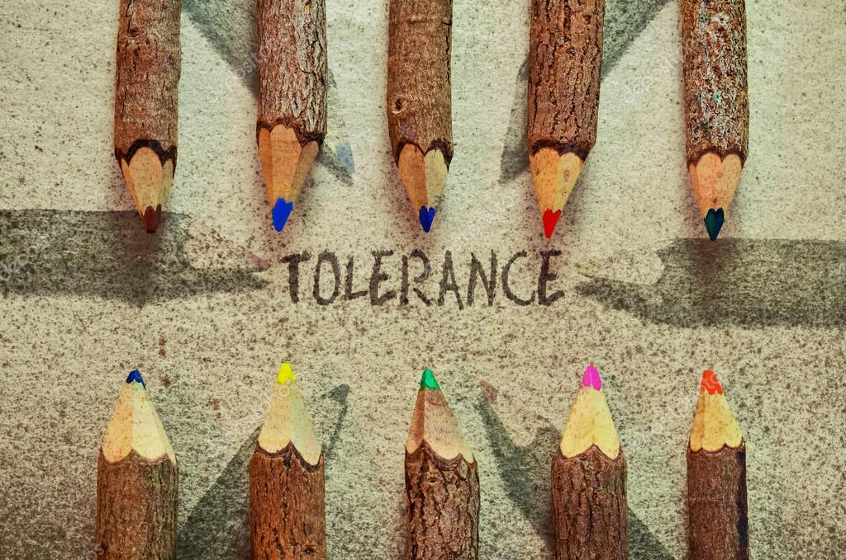
If at least each of us shows more tolerance, then life will become better.

Slide 10
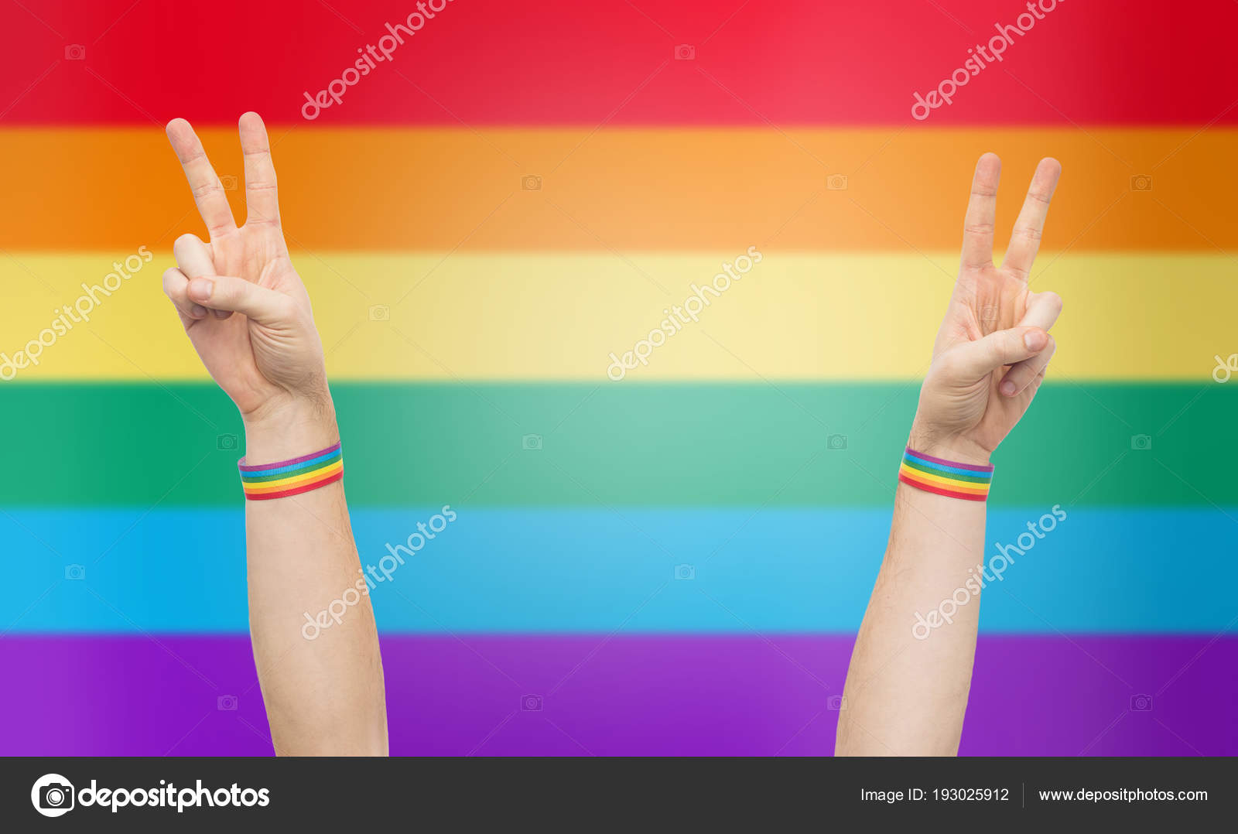
It all depends on our behavior, and only a person can correct it, without the help of others, changing his principles and values.

